Slide 1
Becoming a Hard Money Lender

Slide 2
Documents needed as a Hard Money Lender
Title Company or Attorney
Promissory Note
Deed of Trust or Mortgage
Deed in Lieu of Foreclosure
Usury Laws
http://www.loanback.com/category/usury-laws-by-state/
Qualify the Borrower
Credit
Financial Backing
Experience – Loan Proposal Package

Slide 3
… continue
Qualify the Property
BPO (Broker Price Opinion) or Appraisal
Inspection (You or a Certified Inspector)
Area Comparables
Complete Work To Be Done Proposal
Closing Requirements
Ownership Vested under LLC or Corporation
Insurance on the Property (Vandalism and Liability)
Close at a Title Company or Attorney’s Office

Slide 4
… continue
Recommendations
Start Loan to Value (LTV) at no more than 70%
Increase LTV with borrower’s experience
Always ask for 10 to 30% downpayment
Don’t loan on properties that you cannot undertake in case of foreclosure
Form an LLC per property to back up the loan as per private money lending (file a Deed of Trust or Mortgage as security for the investment)

Slide 5
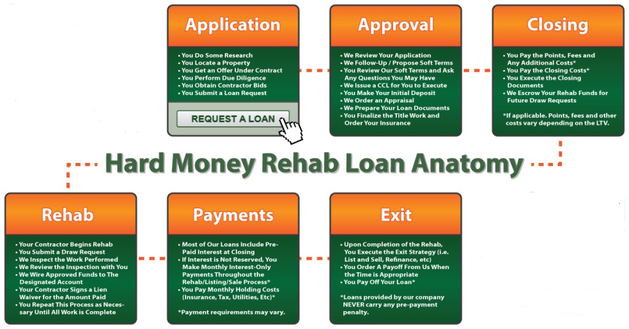
Process (with rehab funds)

