Slide 1
Module 1A – Introduction: Auction Process
Real Estate
Auctions

Slide 2
Preparation
Obtain a list of properties coming up for auction
Due Diligence – Valuation, Condition of Property,
Title Issues
Confirm Auction Date, Starting Bid Price & Terms (Deposit, Payment in Full Terms)

Slide 3
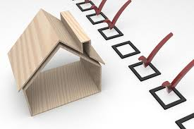
Inspection
Depends on the Auction
You might have to use clever ways to view the property:
Visual inspection as allowed
Research photos on Google or MLS
Talk to neighbors/approach tenants

Slide 4
Registration
Depends on the Auction
Ask when you call during the Preparation phase
if you should register and what the
requirements are

Slide 5
Bidding
Attend an auction before getting ready to bid
Pay close attention – legal description a “must”, but not the address
Due diligence important – auctioneer does not have to state if you are bidding on a first mortgage or what other type of lien
Once opening bid is stated, auctioneer encourages higher bids. Be careful about ‘in house’ bidding

Slide 6
If You Win Auction
Auctioneer will state the winner and close the auction
Auctioneer/trustee or agent will approach you at auction end for paperwork and money

