Slide 1
Welcome!
Before we get started set you your computer and connect to the internet.
Thank you!

Slide 2
Real Estate Marketing 101 Boot Camp
with Laura Al-Amery
Notes:
Welcome to our Workshop, Successful Email Marketing with Constant Contact

Slide 3
Our Agenda

Slide 4
Our Agenda

Slide 5
Introduction
LinkedIn is Powerful
Over 200 million active users
There are over 2.8 million company pages
There are 2 new members every second
Three out of four users are looking for job opportunities
Allows you to connect to others on a professional level

Slide 6
Personal Profile
Profile Page:
This page highlights you as an individual and lists out your qualifications and personal attributes with the options to list out accomplishments you’ve made.
Connect to other people on a personal level and find others who work in your field.
Gives you the ability to look and hire potential staff members, or become hired in your field.

Slide 7
Exercise
If you have a LinkedIn Account log in.
If you do not have a LinkedIn Account sign up for one now.

Slide 8
What is included in a Personal Profile?
Fast Orientation to your Personal Profile!

Slide 9
What to fill in?
Personal Profile Information:
Once you have your account, LinkedIn will ask you to provide more information sometimes in a blue box at the top of your profile.
This information is used to populate your profile, creating a virtual representation of your resume, allowing others to see your qualifications.

Slide 10
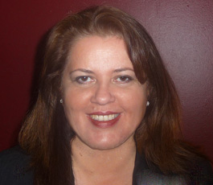
How to Optimize Your Personal Profile
Personal Profile optimization tips:
Use a professional picture for your profile. It’s been shown that profiles with pictures attract more attention.
Fill out all your contact information.
When telling others your skills, don’t forget to include your human abilities or characteristics, it can make a difference

Slide 11
Exercise
Improve or Add 5 things to your profile.

Slide 12
Five Phases of Network Growth
Phase One and Two
Add contacts from your email contacts
Upload contacts from your webmail or mail program address book to find people already on LinkedIn and invite them to connect with you. This is usually offered upon creation of the account.
Find current and former colleagues and classmates and connect with them
Look for work colleagues by searching the company name
Look for classmates via the Add Connections – ‘School Name’.
If you are asked to send a message make it personal, do not use the generic message provided by LinkedIn.

Slide 13
Five Phases of Network Growth
Phase Three, Four, and Five
Discover people you may know and connect with the ones you already know
The sidebar in LinkedIn will show you people you may know.
Grow your network passively
Add a link to your LinkedIn profile to your email signature
Mentioned your LinkedIn profile on your website or blog
Connect with people you don’t yet know
Find a way to relate to the person:
Before sending out a blind connect request, see whom you might know in common. Ask that person if they don’t mind introducing you, or mention in your invite that you happen to know someone in common.

Slide 14
Join Groups in your Industry
Search for Groups
Search Terms “Your City + Real Estate”
Join Groups (limit of 50)
Ask to Join Members Individually from those Groups
Eventually Form Your Own Group

Slide 15
Exercise
Use some of these methods to find 5 people you would like to connect with.
Send them a connection request.

Slide 16
Recommendations
Give and Ask for Recommendations
Give a client, partner, or past business associate a good recommendation.
Then in return ask that connection if they could write a recommendation for you on LinkedIn.
This will quickly build up your recommendations.

Slide 17
Exercise:
Write a recommendation for someone and then send that person a recommendation request.

Slide 18
Our Agenda

Slide 19
#1 Rule on Facebook
Keep it interesting! People are on Facebook to connect and have fun. A dull page gives them no reason to come back. This is not traditional advertising.

Slide 20
#2 Rule on Facebook
Keep it separate. You must have a business page and a personal page.

Slide 21
Personal Page
Don’t sell. You could mention what you did at work, people you met or interesting places you went in the course of work but from a personal point of view.
Show that you have other aspects of your life, makes you more real to your clients.
Maintain good manners – the Internet is forever!

Slide 22
Create a Personal Profile
Orientation to Personal Profile.
Exercise:
Create a Personal Profile.

Slide 23
Business Page
Stick with your brand.
Decide what company culture you want to present – fun, uplifting, conservative?
Stay neutral – the internet is forever!
Keep it interesting. View it from the viewpoint of prospective customers.

Slide 24
Create a Business Page
Orientation to Business Pages.
Exercise:
Create a Business Page.

Slide 25
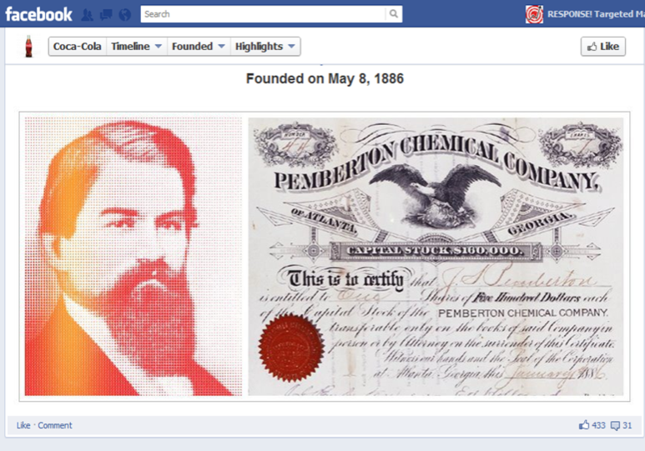
Company History: Timeline
Introduction to Milestones:
How to add a Milestone.
What to put in a Milestone.
Why are they important?

Slide 26
Exercise:
Add a company milestone to your company page.

Slide 27
FACEBOOK TRAFFIC TIP
We have found that uploading images and then adding comments and tags has brought the most traffic – a 2000% increase!

Slide 28
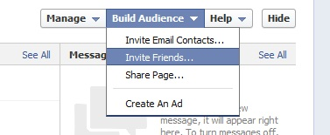
Invite People: Your Friends
Invite all of your personal friends, have your other admins do the same.

Slide 29
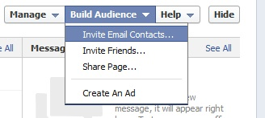
Invite People: Email lists
Invite people by uploading an email list of customers or linking with Gmail, etc. Have your other admins do the same.

Slide 30
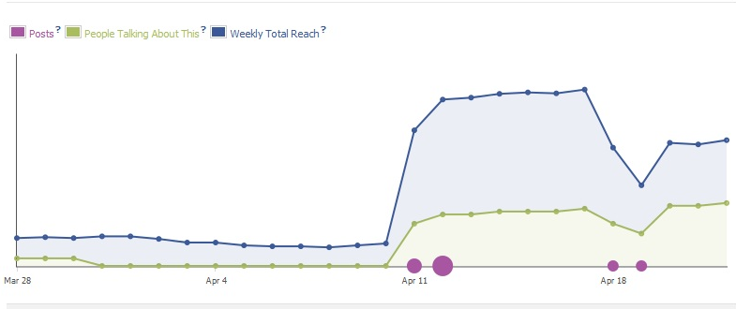
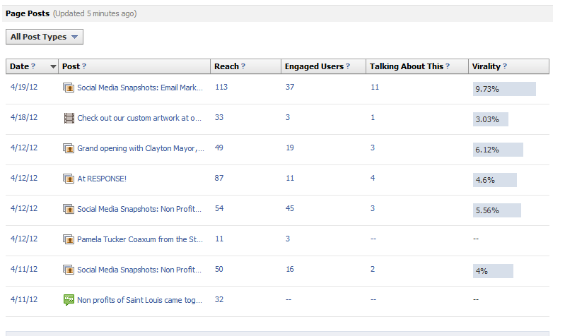
Pay Attention: Monitor Insights

Slide 31
Don’t Forget to Schedule Posts!
Facebook can be distracting, to get the most done do the following:
Have a plan before you log in.
Schedule several posts at a time.
Pay attention to insights and adjust your posts based on what you find.

Slide 32
Exercise:
Schedule 3 posts using the tools I just showed you.

Slide 33
Our Agenda

Slide 34
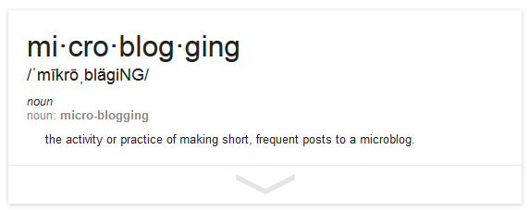
What is Micro-blogging?

Slide 35
Create a Twitter Profile!
Orientation to Twitter!
Exercise:
Create a Twitter profile for your business.

Slide 36
Best Practices for Tweets
Link to external content to give more information.
The average life of a tweet is about 30 minutes.
Use pictures and video links!
Use HootSuite to schedule tweets!
Follow people to get followers.

Slide 37
Exercise:
Open a HootSuite account and connect your Twitter.
Schedule three tweets for the future.
Start following two people who you would like to follow you back.

Slide 38
Our Agenda

Slide 39
Why Google+?
It is important to be on Google+ as a business because it is owned by the most popular search engine.

Slide 40
Create a Google+ Profile and Page!
Orientation to Google+!
Exercise:
Create a Google+ profile for yourself and your business.

Slide 41
Google+ Best Practices
Verify the website and email address. As a brand page on Google+, it’s critical that both your business’ website and email address where customers can contact you are verified.
Setting up your circles. Another aspect that differentiates Google+ from Facebook, Twitter, and other popular social networks is the way you connect with other people.
When sharing, use the “Link” feature. It seems obvious, but I’ve seen things this ignored frequently.
Use HootSuite to schedule posts. This will save you time.

Slide 42
Exercise
Implement some of these best practices on your profile.

Slide 44
YouTube Best Practices
Raw Videos are great!
Post often as YouTube is owned by Google.

Slide 45
Exercise
Create a YouTube Channel.

Slide 47
Exercise
Start Following Boards
Create Your Board
“real estate + your city”

Slide 48
Our Agenda

Slide 49
Let’s Get Started
Open your GetResponse account
http://www.getresponse.com/index/lauraalamery

Slide 50
Creating Content
Best Practices:
Maintain high percentage of content versus advertising.
80% Content:
Inform
Engage
Build Loyalty
20% Promotion

Slide 51
Creating Content
Types of Content:
New Product Announcements
How-To Guides
Company News (and how this benefits the reader)
Upcoming Events
Articles on relevant or related topics
Greetings (holidays, etc.)
Surveys
Sales and Specials
Social Media Presence

Slide 52
Spam Defined
SPAM = unsolicited commercial email
= no relationship
= no permission
PERMISSION:
Explicit = contact took action to join your list
Implicit = prior business relationship with contact (a reasonable person assumes they may receive email).
Notes:
Ask for examples of spam, examples of explicit permission, implicit permission

Slide 53
Avoid Spam Filters
Trigger Words: Page 7
#1
100% satisfied
4U
Accept credit cards
Act Now!
Additional Income
Affordable
All natural
All new
Amazing
Apply online
Bargain
Best price
Billing address
Buy direct
Call
Call free
Can’t live without
Cards Accepted
Cents on the dollar
Check
Claims
Click / Click Here / Click Below
Click to remove
Compare rates
Congratulations
Cost / No cost
Dear friend
Do it today
Extra income
For free
Form
Free and FREE
Free installation
Free leads
Free membership
Free offer
Free preview
Free website
Full refund
Get it now
Giving away
Guarantee
Here
Hidden
Increase sales
Increase traffic
Information you requested
Insurance
Investment / no
investment
Investment decision
Legal
Lose
Marketing
Marketing solutions
Message contains
Money
Month trial offer
Name brand
Never
No gimmicks
No Hidden Costs
No-obligation
Now
Offer
One time / one-time
Opportunity
Order / Order Now /
Order today / Order status
Orders shipped by priority mail
Performance
Phone
Please read
Potential earnings
Pre-approved
Price
Print out and fax
Profits
Real thing
Removal instructions
Remove
Risk free
Sales
Satisfaction
guaranteed
Save $
Save up to
Search engines
See for yourself
Serious cash
Solution
Special promotion
Success
The following form
Unsolicited
Unsubscribe
Urgent
US dollars
Wife
Win
Winner
Work at home
Notes:
First Obstacle if Avoid Spam Filters: Trigger words
Give me examples based on these trigger words of subject lines to avoid

Slide 54
Subject Lines
Best Practices:
To prevent your email from being stopped by spam filters avoid trigger words like free or FREE, do not use excessive punctuation, symbols or misleading content.
Keep it short and simple: 5-8 words. Put the most important information in the first three words.
38-47 characters are visible in the subject line.
Communicate what’s in it for the recipient if they open
Make it informative, as targeted as possible, interesting and trustworthy.
Create motivation to open NOW!
Notes:
Discuss Points

Slide 55
Getting Opened
Please take this survey – We want your opinion about our new cupcakes!
Attend our upcoming event - Last chance to register for Creating Emails That Sell!
May Newsletter from C.F. Association - You can help raise $100,000 for Cystic Fibrosis
20% Off Everything! - We miss you! Come back and get 20% off...
New Yoga and Pilates Classes – Introducing new Chesterfield yoga classes
Notes:
Look at bold examples on the left
Look at improved examples to the right

Slide 56
Pick a Template
Exercise:
Explore and choose a template.
Notes:
We will be creating an email. For the sake of clarity and speed I am going to give you an assignment.
Today we will create an email for a school bake sale.
LIVE DEMO:
Create new email.
Select template selector
Select industry: education
Preview templates
Select Education Template 4.

Slide 57
Editing Template Colors… auto
Exercise:
Put business name at the beginning of the email.
Click on Colors & Fonts- Change some colors.
Notes:
LIVE DEMO:
Put business name at the beginning of the email.
Click on Global Colors & Fonts
Change the Title Background – this large square means there are images that can be used instead of just plain colors
Change the Header Image Block background – right click on image

Slide 58
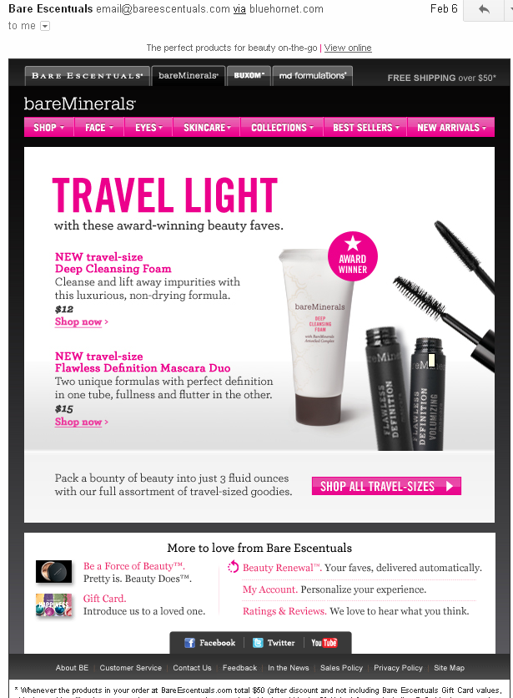
Insert and Format Text
Best Practices:
Use bullets and headings to draw attention to topics.
Separate articles into different blocks for easier formatting.
Notes:
Page 2
LIVE DEMO:
Re-write Event 1 Header.
Re-write Event 1 Sub-Header.
Re-write Event 2 Header.
Re-write Event 2 Sub-Header.

Slide 59
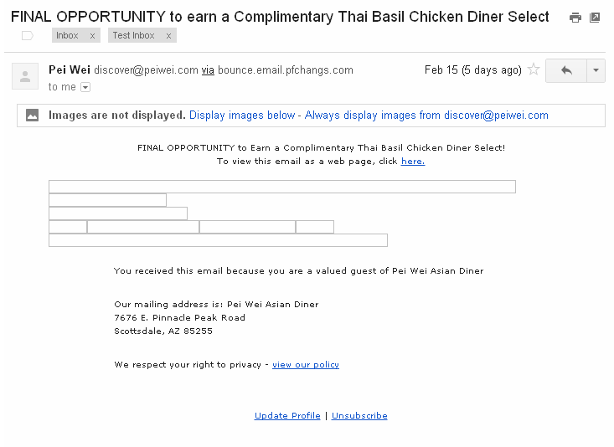
Image Descriptions
Make sure to fill in useful descriptions:
Images do not automatically display so ensure there are useful descriptions.
x
Notes:
Discuss screen.

Slide 60
Insert Link to Website or Blog
Best Practices:
Link to full articles on your website and blog. Not only will this make your email a more inviting read but it will provide valuable data in your reports later on.
Format hyperlinks to look like obvious hyperlinks.
Use descriptive display text for hyperlinks.
Notes:
Links provide valuable tracking info. Each link you add is a “survey” or “market research” of what readers find interesting when they guard is down.
Usability of hyperlinks
Descriptive display text for use in tracking interest

Slide 61
Adding Contacts: New Lists
Note: Duplicate email addresses will never be created in the system so you don’t have to worry!
Exercise:
Click Create New Campaign
Add a list called “Test”.
Save.
Notes:
LIVE DEMO:
Click Create New.
Add a list called “Test”.
Save.

Slide 62
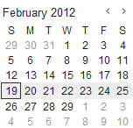
Test Timing
Test for timing: Divide your lists and send email at different times to compare results.
List 1
List 2

Slide 63
Track Results
Best Practices:
Use your reports to learn and improve your emails, timing, content.
Check which links they click to find out what they are interested in.
Use reports to view and learn about when your contacts opened their last emails.
Check your unsubscribe rates (opt-outs) and spam reports to ensure you are not over emailing or relevancy of content.
Notes:
LIVE DEMO (on Trex Promotions)
Use your reports to learn and improve your emails, timing, content.
Check which links they click to find out what they are interested in.
Use reports to view and learn about when your contacts opened their last emails.
Check your unsubscribe rates (opt-outs) and spam reports to ensure you are not over emailing or relevancy of content.
Ask, “Who does aggressive sales – such as calls or visits to prospects?”
Demonstrate how to view prospects using reports.

Slide 64
Manage Bounces
Best Practices:
Check which addresses failed and how many times in the past 90 days.
Check for misspelled addresses or contact data on file.
If you can’t correct add them to Do Not Mail.
Notes:
LIVE DEMO (on Trex Promotions):
Check which addresses failed and how many times in past 90 days.
Check for misspelled addresses or contact data on file. If you can’t correct add them to Do Not Mail.

Slide 65
“Must Have” Tools
http://www.getresponse.com/index/lauraalamery
monitor
+
schedule
http://www.jdoqocy.com/click-4185398-10914669

Slide 66
Our Agenda

Slide 67
Set up your blog!
Free?
Wordpress.org
Paid (Recommended)
Wordpress.com

Slide 68
Set up your blog!
Hosting
http://www.webhostingpad.com/12772.html
Templates
http://www.enough.pro/10-surprising-free-real-estate-wordpress-themes/

Slide 69
Orientation to WordPress
Orientation to WordPress.
How to Post
How to insert images.
How to manage your comments.
How to schedule a post.

Slide 70
Our Agenda

Slide 71
Best Practices for Direct Mail
Include a headline that inspires action.
Be sure to figure out and include an offer with a call to action.
Be sure to use the correct list and great graphics.
“The Best List is the one you generate yourself”

Slide 72
Direct Marketing
Look Professional
Use Letter with Envelope or Oversized Postcard
Highlight Benefits to Them (It is not about you)
Be Yourself and True
Offer Something of Value (Money, Assistance)
Make Them Open the Envelope (“Trigger” Line)
(see samples)

Slide 73
Advertising
Internet Advertising
Offline Advertising

Slide 74
What’s next?
Create a strategy and schedule to do updates – “Editorial Calendar”
We are also offering a couple of packages which we will help you with the next steps.

Slide 75
Full “Done It For You” Package
Set Up Hosting and Domain Name
Set Up Branded Blog
Email Template which has been customized with your branding
Set Up All Your Social Media Channels & Groups
Set Up Your Google Adwords & Facebook Campaigns
$997

Slide 76
Monthly Maintenance Package
Social Media posts 3 times a week on each of your platforms.
Review of your monthly e-newsletter & blast out emails (2 a month)
Review of your monthly blog post (SEO optimized)
Review of your direct marketing material
Review of your Google Adwords and Facebook campaigns
Syndication of your content and articles
$297

