Slide 1
Module 1B – Introduction
Luxury Real Estate
Investing

Slide 2
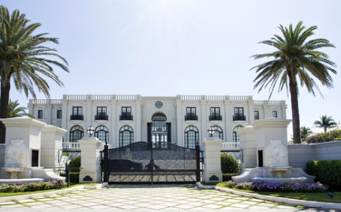
Choosing the right area
Most metropolitan areas have a luxury market;
Real estate agent research:
Luxury Homes areas ($1-million +)
Cash sales ($3-million + are mainly cash)

Slide 3
Why Invest in Luxury Real Estate?
The market for luxury real estate is strong and growing.
Luxury home sales in many vacation communities across the U.S. are soaring, driven by cash purchases and rising stock portfolios.
The resurgence of the upscale-home market is expected to accelerate due to increasing investor confidence and the targeted marketing of properties to the very affluent.
The wealth of the world’s richest people is at an all-time high, according to Forbes, therefore the potential market for luxury properties is larger than ever.

Slide 4
Defining “Luxury Real Estate”
It has to be unique and exclusive;
People who are wealthy will pay a premium for something that’s perceived to be superior;
High-end buyers want access to luxury activities like high-end shopping, dining and the arts, as well as proximity to other luxury homes;
A trophy address, like Park Avenue in New York City, adds value;
Many luxury buyers seek the natural beauty of a waterfront location, or at least views of a river, ocean or lake. Others want countryside or mountainside views;

Slide 5
What do the High End Buyers Expect?
High-end buyers want many of the same features that all buyers want, but on a grander scale;
They want privacy and security, sometimes to the point of seclusion;
They want beauty inside and out, and can afford custom architecture, custom design, over-the-top attention to detail and opulent finishes;
They also want amenities on top of amenities: a chef’s kitchen, luxury pool, expansive master suite and outdoor living space, not to mention home automation, motion detectors, car lifts and temperature-controlled wine cellars;
They also want space. In Malibu, Calif., for example, the average luxury home has more than 4,000 square feet

Slide 6
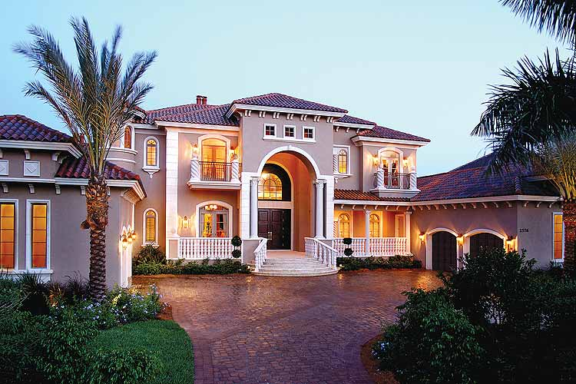
Who are the Luxury Real Estate Buyers?
You have 2 type of Luxury Real Estate Buyers:
Private Buyers;
Investors.

Slide 7
How to Identify the Buyers?
Private Real Estate Buyers:
Dream Homes
Second Homes
Land Investments
Vacation Villas
Timeshares
Commercial and Residential Rental Properties
Real Estate Investment Trusts (REIT)
Real Estate Investors (Think International):
Home Value
Multiple Home Owner
Net Worth ($10M - $20MM+)
Investable Assets

Slide 8
How to Identify the Sellers?
Strategic planning is important
Build a Brand
Presentation is Very Important:
Marketing Material;
Personal Appearance.
Join a Well Known Luxury Real Estate Company (if licensed – i.e. Sotheby’s International)
Work with an Agent Associated with a Luxury RE Agency (for Expired Listings, for example)
Network – Social Events, Country Clubs, Charity Events, etc.
Direct Marketing

Slide 9
Skills Development

