Slide 1
Laura AlAmery
Presents
Coach Mitch’s
Ridiculously Simple System…™
The Science to the Art of Smart Selling

Slide 2
DISCLAIMER
This document and accompanying options shall be used for informational purposes only and shall NOT be construed as legal advice.
Mitchell Goldstein / Coach Mitch is not an attorney and does not offer legal advice. A licensed attorney and/or other professionals MUST be consulted prior to the use of any of these documents and information.

Slide 3
Coach Mitch’s famous $1 Option.
With only $1, control property, without any liability.
The single most powerful contract in the real estate investing world is the Option.
How else can you take control of unlimited numbers of property, with only $1 each, make significant profits without owning the property, and best, without being liable for the properties upkeep, the mortgage, taxes or anything else.
The record: $1 took control of a restaurant valued at $1,600,000 using Coach Mitch’s famous $1 Option.

Slide 4
Coach Mitch’s
Ridiculously Simple System…™
1. Determine geographic area
2. Get list of properties at risk = Tax Delinquent Roll
1. Questions to ask County Officials
3. Sort the list for your type properties
1. Searching for property
2. Property Desirability Matrix
3. Coach Mitch Post 201
4. Market to your list
1. Simple Postcard
2. Letter for deed
5. Negotiate and Close
1. Favorite Sales Techniques
2. Attitudes
3. The Formula
4. Property Evaluation Worksheet
5. Seller’s Acknowledgments
6. Role Playing

Slide 5
Coach Mitch’s
Ridiculously Simple System™
2. Get list of properties at risk = Tax Delinquent Roll
1. Questions to ask County Officials

Slide 6
The science to the art of smart selling
The SCIENCE in selling is to understand why you do something, how to do it, what to expect and to be ready with the next step. = Anticipation Selling
The ART is to converse with style and knowledge aforethought, i.e. acting, NLP.

Slide 7
Neurolinguistic Programming
A connection between the neurological processes ("neuro"), language ("linguistic") and behavioral patterns learned through experience ("programming") and that these can be changed to achieve specific goals in life.
EX body language, facial expression

Slide 8
Questions to Ask County Officials
2 If someone does not know some information you need, then ask, “Who might know that information?”
“ What is their name, title, their phone, their duties”
“Do they have an assistant? What is that person’s name, title, phone, and duties?”
The SCIENCE is to know what you want and how to get it.
3 Frame your questions carefully. Play to their vanity. The very best thing that you can do is to make a government official feel important, but not in an obvious way.
The ART is to do it with style and knowledge.
EX: Compliment something they did well…
If they say something well, “Very good. I understood it the way you explained it, thank you.”

Slide 9
If sensing a pause and wanting more info, “Great, what happens next?”
If wanting them to continue speaking, “That’s interesting, please continue.”
If you didn’t hear something,
“I’m terribly sorry, could you please repeat that?”
If confused on a point,
“I missed something, could you expand on that please?”
If wanting more information, “Very good, please say more about that?”
If excited about something, “Oh wow! How can I find out more?”
Did you notice that I have a phrase prior to my statement which acts as an exclamation?
This is what makes the speaker “feel” good.
“Great,” or “That’s Interesting,” shows that you are pleased with their performance and therefore the speaker is pleased that they have accomplished something good.
Just don’t make it obvious. Enthusiasm should be genuine.

Slide 10
7 “How long must the property be delinquent before it becomes subject to being sold for non-payment of taxes? “
This is a great question. You will routinely see properties that are tax delinquent for a significant number of years - but they have not been put up for tax auction. One can only speculate why this happens.
8 “What process is used to determine which properties are chosen to be included in the tax deed auction? Who makes that decision?”
Another great question. The answer will lead to that counties decision making process. Invaluable.

Slide 11
9 “What happens after a property is chosen to be part of the tax auction? I am curious about the internal processes?”
In tax deed states, this often means that the county has come to own the property, that redemption rights may not be in place and that the county has to do title work for the purpose of due process and perhaps they create a work file, a maintenance record and do an in-house appraisal for that property. Because I am on good terms with my tax collectors, I often get to look at these records. WoW!

Slide 12
13 “When is the very last moment that a tax delinquent can redeem their property?”
You must know this information. It will guide many decisions. Each state is different. Each county is different. Read the law. Speak with the county attorney for his opinion. The policy of the taxing jurisdiction may be different than what statute dictates. The local policy may be more liberal.
14 “Which section of statute requires how and where the records of tax delinquent property owners shall be maintained?”
This question is crucial. You should understand the importance of asking the question in the manner that I propose. You infer that you know that statute governs this area and you just want to know the specific section.

Slide 13
“What happens to property or TLC not sold at the auction?”
“What happens to any Excess Proceeds?”
25 “Has the county passed any laws or regulations in addition to the state statutes?”
This is extremely important information to know.
28 “Who is in charge of creating the computer records of the tax base?”
29 “Who prints out the tax bills?” or “What office prints out the tax bills?”
Really good questions.

Slide 14
31 “Are you familiar with the rights of citizens under the public records statutes of your state?”
You should go in prepared. Research the public access laws in your state. You will be happy when you read that the public (that’s you) has a right to see any public records – in the formats that are available to government. Have a copy of the public records law with you.
34 “How much does it cost for a CD to be created of the tax delinquent data base and can it be created in CSV or Excel format?”
This is what you really want.
REMEMBER: you are doing research – not investing
If you already know the law and tax auction procedures, you can concentrate on getting lists.

Slide 15
Coach Mitch’s
Ridiculously Simple System™
3. Sort the list for your type properties
1. Searching for property
2. Property Desirability Matrix
3. Coach Mitch Post 201

Slide 16
Researching Tax Delinquent Lists without the Property ID code
Property Search Excel Files:
  1. Open tabs in a browser for:
    Property Assessor
    Tax Collector
    County Clerk
  2. Open the Excel File
  3. Select/Copy a Parcel Number
  4. Paste Parcel Number into Record Search box of Property Assessor
    Be sure to select “Parcel Number” to search
  5. Determine type of property and your interest, i.e. Property ID Code
  6. See GIS map for property
  7. Goto Excel file and color the line for further reference
    Color Category all light pastel colors
    Green = SFH
    Purple = 2-4
    Blue = 5+
    Orange = Commercial
    Grey = Misc
    Yellow = Special

Slide 17
  8. Alternatively, you can paste the Parcel Number
  AND/OR the put the address into Google
  See the Street View to determine interest
  9. Goto Tax Collector, often via a link on Property Assessor page
  10. Paste Parcel Number into Record Search
  11. Determine the ratio of Total Taxes to FMV
  Part 1, Manual 1, Operations Manual Page 48
  12. Goto County Clerk
  13. Input owner’s name into Document Search to see if liens or other legal encumbrances exist against property
  14. Determine if you want to market to this prospect
  15. If “yes” then seek the phone number
  16. Send the proper postcard or letter to prospect

Slide 18
Detail | Tax Number | Base Bid | Highest Bid | Type | Name | Parcel Number | Status | Sale Date
View | 342010 | $8,001.98 |  | A | DBW TL HOLDCO 2013 LLC | 00414713280040010 | READYSALE | 06/11/2014
View | 412010 | $8,023.33 |  | A | DBW TL HOLDCO 2013 LLC | 00414713280070010 | READYSALE | 06/11/2014
View | 492010 | $8,023.33 |  | A | DBW TL HOLDCO 2013 LLC | 00414713280100030 | READYSALE | 06/11/2014
View | 2382010 | $3,900.90 |  | A | DBW TL HOLDCO 2013 LLC | 00424329270195205 | READYSALE | 06/11/2014
View | 23702010 | $50,472.81 |  | A | JUNO TAX LLC | 00414220000008230 | READYSALE | 06/11/2014
View | 42342010 | $6,821.56 |  | A | POWELL LINK II LLC | 00424301050170231 | READYSALE | 06/11/2014
View | 43482010 | $6,396.35 |  | A | PPF HOLDINGS III LTD | 00424313121150041 | READYSALE | 06/11/2014
View | 43652010 | $7,848.02 |  | A | PPF HOLDINGS III LTD | 00424313200044200 | READYSALE | 06/11/2014
View | 43682010 | $5,326.05 |  | A | PPF HOLDINGS III LTD | 00424313200066190 | READYSALE | 06/11/2014
View | 43772010 | $5,370.13 |  | A | PPF HOLDINGS III LTD | 00424313200161609 | READYSALE | 06/11/2014
View | 46722010 | $3,685.19 |  | A | PPF HOLDINGS III LTD | 00424323080040155 | READYSALE | 06/11/2014
View | 46772010 | $2,926.55 |  | A | PPF HOLDINGS III LTD | 00424323080070253 | READYSALE | 06/11/2014
View | 47102010 | $3,676.55 |  | A | PPF HOLDINGS III LTD | 00424323140153550 | READYSALE | 06/11/2014
View | 47682010 | $3,062.36 |  | A | PPF HOLDINGS III LTD | 00424323210071790 | READYSALE | 06/11/2014
View | 52582010 | $7,968.92 |  | A | WELLS FARGO BANK OBO TAX LIENS SEC TRUST 2010 1 R1 | 00424326010000180 | READYSALE | 06/11/2014
View | 53952010 | $14,015.23 |  | A | PPF HOLDINGS III LTD | 00424326190000022 | READYSALE | 06/11/2014
View | 54102010 | $5,278.85 |  | A | PPF HOLDINGS III LTD | 00424326220000010 | READYSALE | 06/11/2014
View | 54142010 | $5,323.74 |  | A | PPF HOLDINGS III LTD | 00424326220000180 | READYSALE | 06/11/2014
View | 54162010 | $5,392.28 |  | A | PPF HOLDINGS III LTD | 00424326220000260 | READYSALE | 06/11/2014
View | 54182010 | $5,365.35 |  | A | PPF HOLDINGS III LTD | 00424326220000330 | READYSALE | 06/11/2014

Slide 19
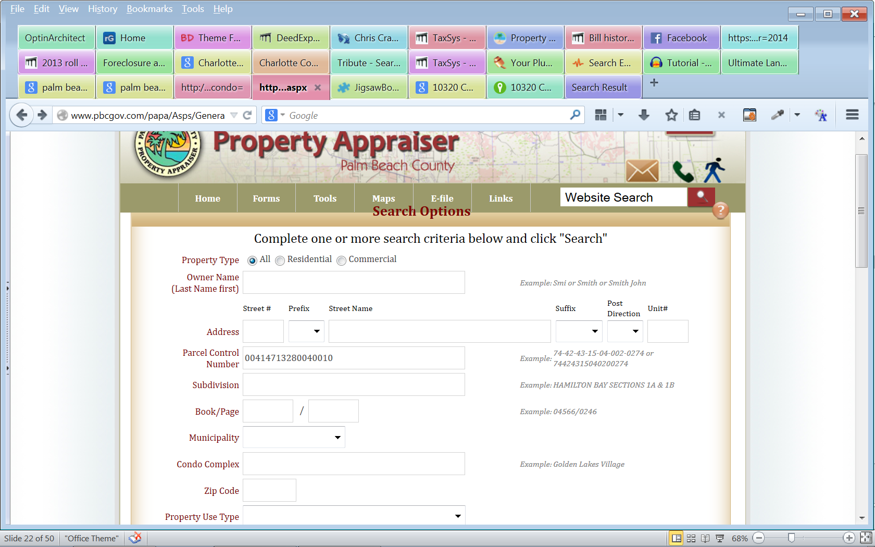

Slide 20
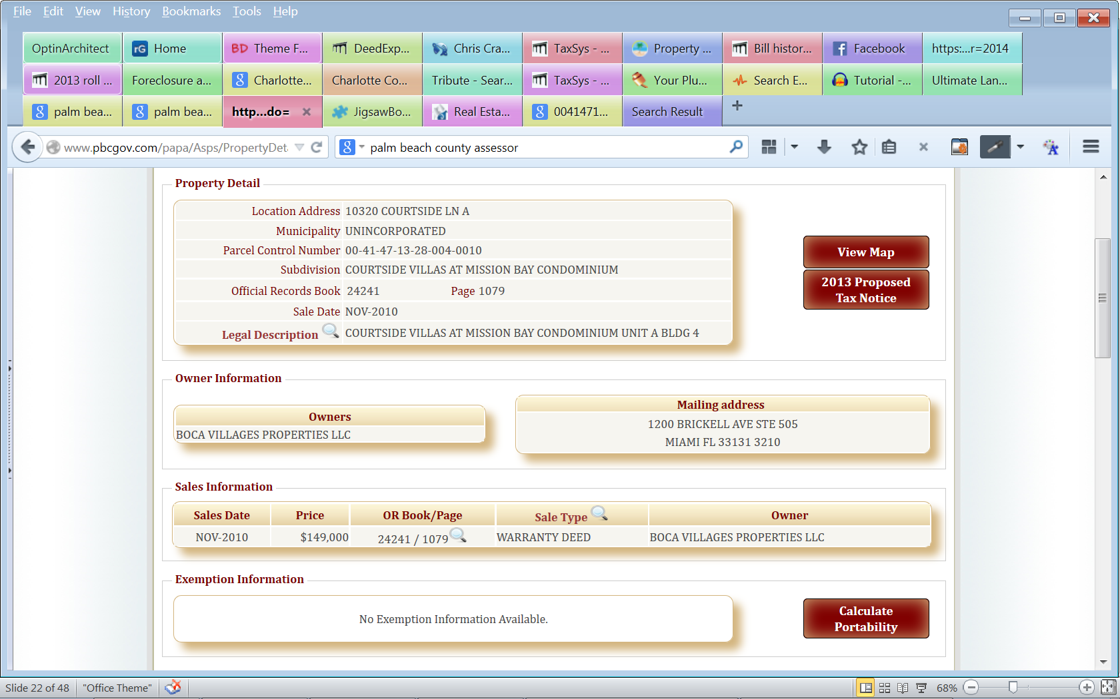

Slide 21
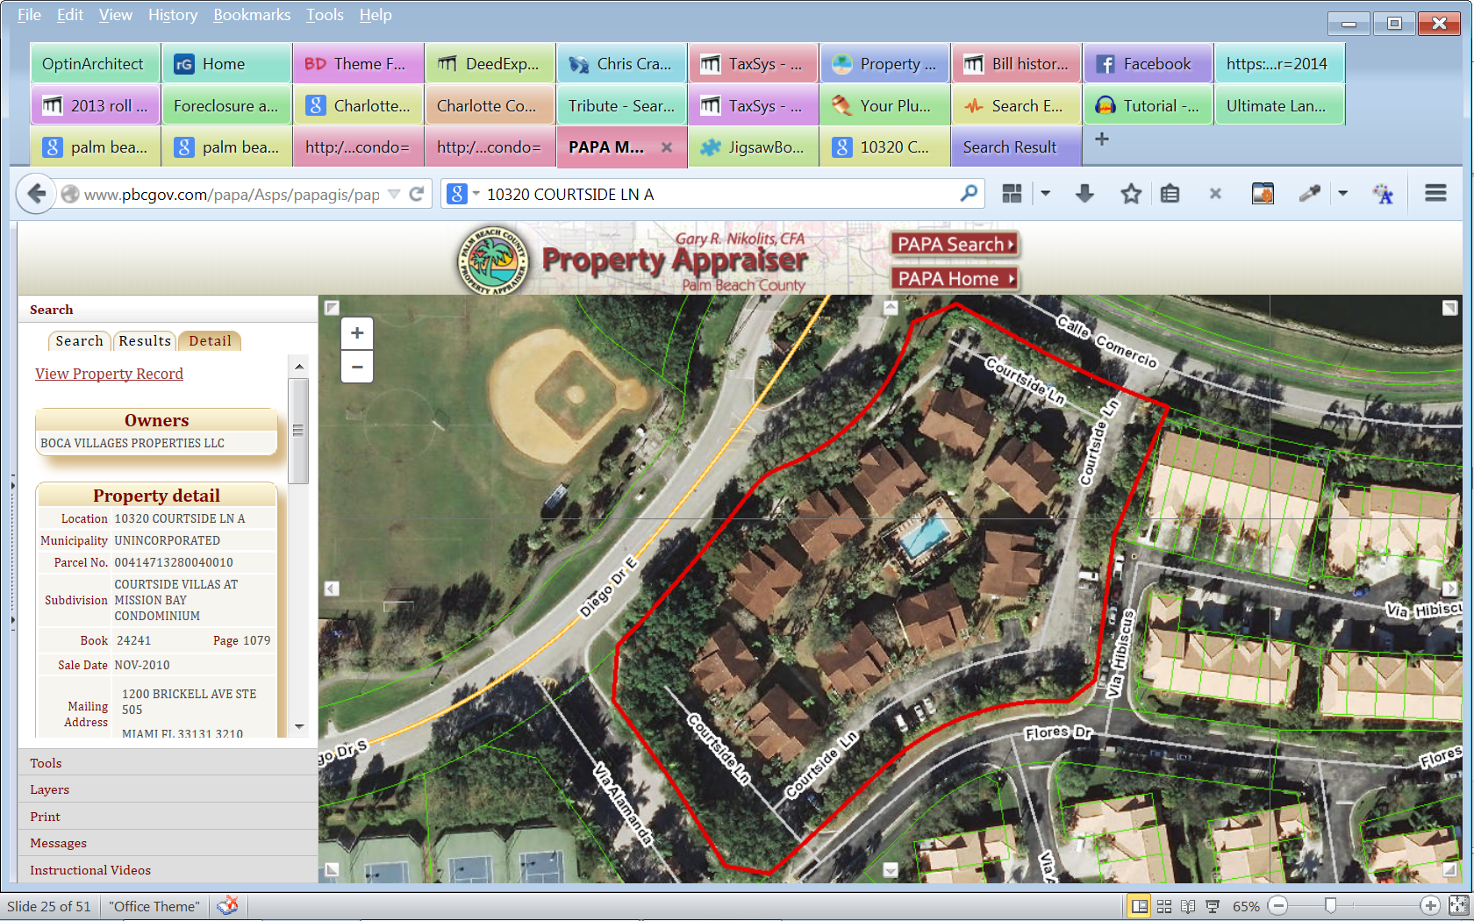

Slide 22
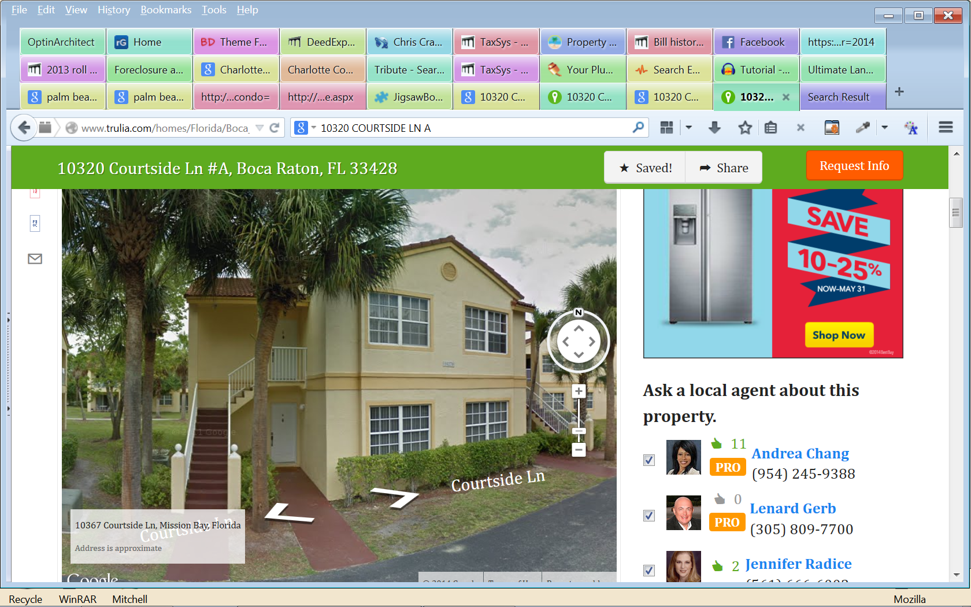

Slide 23
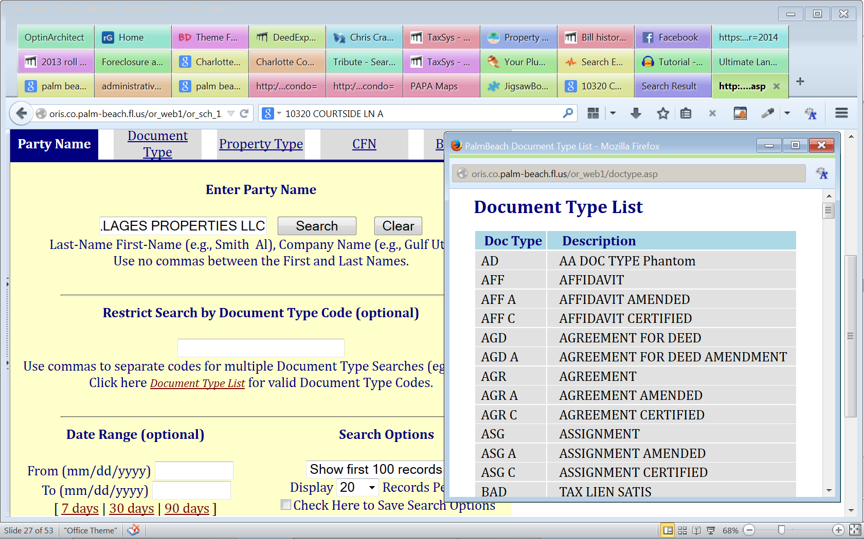

Slide 24
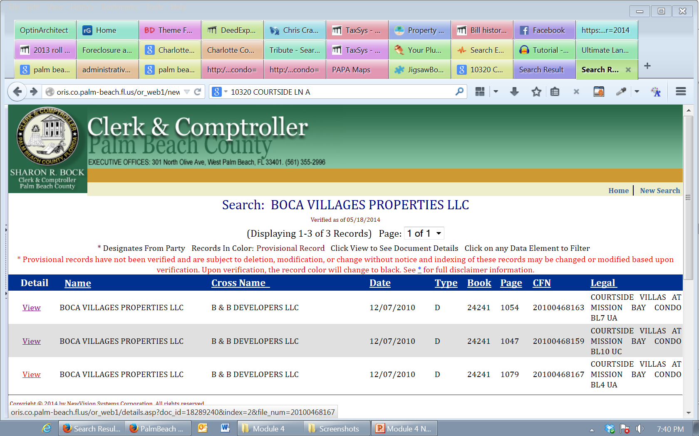

Slide 25
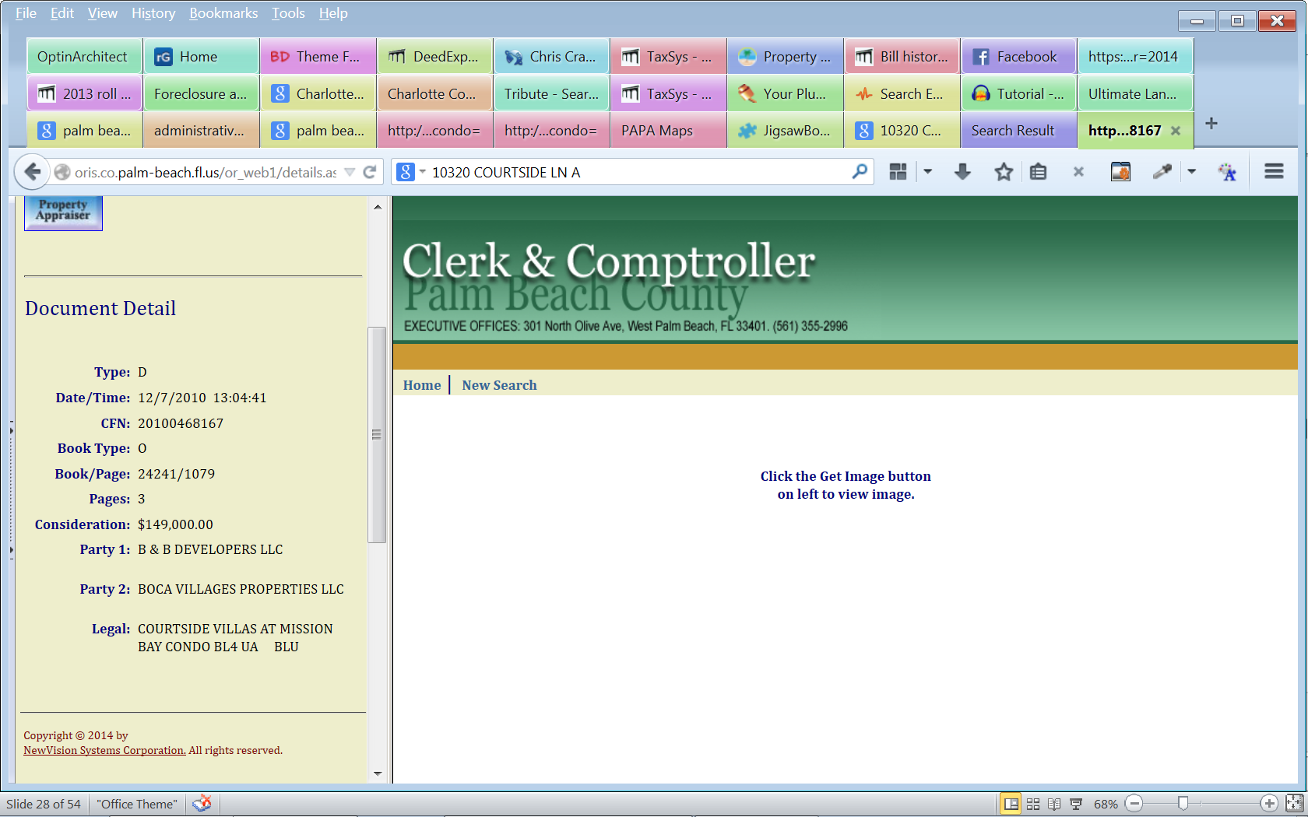

Slide 26
After determining which properties you are interested in, you can order telephone numbers and emails.

Slide 27
TAX DELINQUENT PROPERTY -- DESIRABILITY MATRIX
1 Rank the type of property that you want to work on the most.
2 Then rank the geographic areas by desirability.
3 Choose properties based on your determination of what it is smart to work on, mostly based on resale value and property desirability.
Property Desirability Categories
A Property that is perfect for you
B Property that seems good for you but is second tier.
C Property that seems interesting but do not fit your profile.
D Property that does not fit your desirability profile. This is property that you do not want and should not spend time researching.

Slide 28
AVAILABILITY OF PROPERTY
TAX DELINQUENT PROPERTY -- DESIRABILITY MATRIX
 |  | Want and Can Get 1 | Want But Hard to Get 2 | Available But Shouldn't 3 | Most Available But Don't Want 4
D E S | Perfect A | Lots in subdivision, SFH | Boat Slips, Golf Course Lots, Lake front | Speculation
I R A | 2nd Tier B | Ghetto properties in very hot mkts 2-4 Fam Mixed Use | Acreage, Small Comm Multi Family | Mid size Commercial, Rural Lots | Landlocked, No market
B I L | Shouldn't C | Lots needing variances, Ghetto RE in a slow market | Large subdivision | Large Commercial, Ghetto Lots (unless putting up new mods) | SFH needing lots of work
I T Y | Bad D | Anything you haven't seen, Property that is too costly |  | Little Strips of Land, Landlocked, Wetlands | Gas Station w Issues

Slide 29
Coach Mitch’s REFLECTIONS™ Post 201
Needing more clarity, a student recently asked me to quantify what he should be looking for to determine what a good tax delinquent property prospect was.
I jotted down a few ideas.
The biggest idea is that: Every criterion has its range of values, issues and concerns. A good lead takes several criteria into consideration.
Price or FMV:
Typical =
< $40K lots of houses are free and clear,
< $60K many are free and clear,
$60K > fewer are free and clear,
$75K> few are free and clear.
In each area the properties have a higher potential of being mortgaged above a certain amount. However, as a general rule, percentage wise, there are few properties above $75K that are free and clear AND tax delinquent.
In lower priced areas, fewer homes are mortgaged in the lower price range, i.e. a higher percentage are free and clear. In higher priced areas, that percentage is lower and the amounts are higher; because the banks, in order to be in business, must adjust their criteria to the values of the area, i.e. neighborhoods.
In lower priced areas, the banks must lend to lower priced properties or they will not do any business at all. However, the banks can set a higher minimum mortgage amount where the values are higher.
In very high priced areas like CA and metro NYC, $100K properties can be free and clear because they are the equivalent of $35K properties in FL or AL. Banks often require a high percentage of down payment for higher priced properties and that can mean large amounts of equity.
Exception: 33% of homes of persons 55 and older are free and clear; however, they are not usually tax delinquent. These prospects are good, full price, owner hold paper leads.
Total Assessed Value to the FMV can be a big factor. If an area is well under assessed, then you must adjust for this fact or mistakenly believe that people are asking too high a price compared to the Assessed Value. If the area is well over assessed, then you had better know or you will be overpaying.
We can look at property to about $150K and find some that are free and clear or with low mortgages, so that the equity is still significant, about 30% to 40%. These are great $1 Option candidates.

Slide 30
Tax Delinquency Percentage:
Typical = Sweet Spot = 7% – 30% of the total FMV value are tax liens.
If the template is to not go over 50% FMV in price, then, all costs of the property must be within that 50%, not including rehab. The ARV, After Repaired Value, is a different calculation. The 30% maximum in liens allows for a maximum 20% amount to be paid to the owner, totaling 50%. If the owner will take nothing, then the liens can be 50% of FMV.
Tax Delinquency Dollar Amount:
Typical = 7% – 30% of the total FMV value are tax liens, with an approximate minimum delinquency of $3500, e.g. $50K FMV w $3500 tax = 7%.
The dollar amounts are also a function of the area and the property value; however, with rents being $500+, prospective tenants know that they need $2000+ to move in. Most everyone can come up with that figure, so a higher, more difficult amount to save is needed.
The higher priced an area, the higher the dollar amount needed for a tax delinquent to be desperate. A tax delinquent that previously had the ability to get a $500K mortgage paid $50K to $60K per year in PITI, Principle, Interest, Taxes and Insurance. That person is not going to be intimidated by a $3500 delinquent tax bill; $35000 (7% x $500K) is a different matter.
At the low end, though annual property taxes in many states are about 1% of the FMV, the population is not likely to have the ability to save or put together $5000. That is why they are willing to sell cheaply. They are living pay check to pay check.
If you can determine their situation, you can determine a buying price; the worse the situation, the lower the price. This idea is the same with the higher prices homes; the situation impacts the price. Often, the situation mandates speed. Even if they had big money, they don’t have it now, however they know that they can come back to prosperity in the future. They just need to deal with the situation now so they can have a future.

Slide 31
Property type:
To do quick flips, SFR and duplexes are the best candidates.
Tri’s and fourplexes are next best. Currently, even townhouses and condo’s are decent leads because the housing stock has dried up a bit and the better deals can be found in the condos. People will always go to the best deal, even if it is a condo. Be really careful with MH’s.
If looking at fourplexes, then mixed use can also be evaluated. The downstairs store with the upstairs apartment is a prevalent property type and can be very profitable. The percentage of debt to value should be even better, i.e. lower, because the problems will be bigger, i.e. the Sweet Spot can be 5% – 25%. A tax delinquent owner needing to rehab a storefront knows that a potential retail tenant will demand a much lower rent and will therefore understand a much lower purchase offer.
Motivation:
Is the seller desperate? Y or N?
There is no rule, excepting that we find out if the situation is bad enough for the seller to be desperate.
The out of area owner is often thought to be a good motivated seller lead. This is often true and, just as often, the owner occupant is motivated to move on. Do not pre-judge. Dig until you find the hot button and the level of motivation.
If lots of motivation exist, then purchase; if not then use Coach Mitch’s “famous $1 Option.”™.
Listen to everything, evaluate and put the data into your mind matrix, to be reevaluated when getting new information. Example: Me: “Why don’t you rent the house?” Tony: “It’s too far away to manage. I have rental property down here.” This person is not desperate and will not be desperate in the future because he has income. The tax delinquent property is certainly a nuisance; however, aggravation is not desperation.

Slide 32
Issues:
The only real issue is if you feel comfortable putting out some amount for a cash purchase.
For all else, use Coach Mitch’s “famous $1 Option.”™
Q: Is the area someplace that I would live? A: You are not living there, that area already has lots of people who choose to live there; someone will know of a candidate to purchase, especially if you offer a
$300 REWARD.
Q: Is a rehab needed? How do I verify the cost and the work? How do I do long distance supervision? A1: Sell AS IS A2: hire a Craig’s List person to clean and only pay upon seeing before and after pictures, or pay a higher amount upon a sale, add a bonus if they find the buyer. A3: Hire a reputable retired contractor to be your Clerk of the Works.
Q: Can I find a RE agent? A: Of course you can. For the listing, that agent will supervise almost everything – for free. They will love offering their network the chance to do work for you. Only do PP&C’s, Paint, Patch, Carpet, Cleanup and Curb Appeal, and you won’t be hurt. No structural work.
Q: Can I know about the Assessed Value to FMV? A: Ask the Property Tax Assessor, that’s why G-d invented them.
Q: Can I supervise it all? A: See below
Concerns: Can I really do this?
A2: Yes you can do this! That is why you hired a coach – so the potential of failing will be lessened. That’s a really smart thing to have done – but only if you follow the coach’s suggestions.

Slide 33
Coach Mitch’s
Ridiculously Simple System™
4. Market to your list
1. Simple Postcard
2. Letter for deed

Slide 34
Mr. Tax Delinquent
To address the tax bill is sent
Someplace, USA 12345
Front of Postcard #1
The Wilshire Trust
POB 416
Glenmont, NY 12077
www.WilshireTrust.org
WilshireTrust@hotmail.com
518-439-6100 7AM–11PM EST
1st Class
Bulk Mail
Stamp
OR Indicia

Slide 35
Dear Mr. Tax Delinquent 11/22/05
The Wilshire Trust would like to speak to you about your property in: Albany County New York State
Parcel ID: 123-45-67890.123
Address: 495 Someplace Street, Nice Place NY 42952
We might be interested in acquiring your property, but it is important that we speak quickly.
Please call 518-439-6100 between 7 AM - 11 PM EST.
Thank you,
James Wilson, Trustee
Rear of Postcard #1
NOTICE Wilshire Trust
is a private real estate developer

Slide 36
Mr. Tax Delinquent
To address the tax bill is sent
Someplace, USA 12345
Front of Postcard #2
The Wilshire Trust
POB 416
Glenmont, NY 12077
www.WilshireTrust.org
WilshireTrust@hotmail.com
1st Class
Bulk Mail
Stamp
OR Indicia

Slide 37
Dear Mr. Tax Delinquent 5/22/14
The Wilshire Trust would like to speak to you about your property in: Albany County New York State
Parcel ID: 123-45-67890.123
Address: 495 Someplace Street, Nice Place NY 42952
We would like to see if your property qualifies for our project.
If so, we would defiantly seek to purchase your property.
Please email your contact information, including telephone numbers and the best times to contact you.
Thank you,
James Wilson, Trustee
Rear of Postcard #2
NOTICE Wilshire Trust
is a private development firm

Slide 38
«Date» NOTICE
«Street Address» «City», «St» «Zip»
EVERGREEN TRUST IS A PRIVATE REAL ESTATE SPECULATOR - NOT A GOVERNMENT AGENCY
RE: Your «County» County, New Mexico Property. MAIL MERGE
Property ID NO: «Parcel No, Address» From Tax Delinquent Excel List
Dear «First Name» «Last Name» Send a letter NOT a postcard
As real estate investors, we check the public records. The property at «Parcel No» or <<address>> was listed as delinquent for non-payment of taxes. This property will be taken from you and offered for sale at public auction if the taxes and penalties are not paid prior to the tax sale.
If you have not already paid the taxes on this property you can benefit by giving me a Quit Claim Deed to the parcel, in return for a small payment. If, and only if, you do not intend to pay the accumulated taxes, interest and penalties, I will relieve you of your serious tax burden.
I will find a family who will cherish your property and think of you in their prayers.
Please contact us as soon as possible. If you want to be out of this real estate, we will send you $100. for the property, thus creating a “Capital Loss”. This provides a considerable value by giving you a substantial tax deduction, allowing you to legally significantly reduce or even eliminate your income taxes, probably, for many years to come.
Please complete the enclosed Quit Claim deed. Notarize the deed. Return the deed to us in the enclosed self addressed stamped envelope and we will promptly send you $100.
Sincerely, EVERGREEN TRUST

Slide 39
Coach Mitch’s
Ridiculously Simple System™
5. Negotiate and Close
1. Favorite Sales Techniques
2. Attitudes
3. The Formula
4. Property Evaluation Worksheet
5. Seller’s Acknowledgments
6. Role Playing

Slide 40
My favorite sales devices or sales techniques are:
1 Clarifying Questions: Asking questions with a purpose in mind. 5W2H who what when where why how & how much
2 Feel, Felt, Found: “I understand how you feel, I felt the same way myself, until I found…(then, give new info).”
1st Acknowledgment, 2nd Acceptance, 3rd However…
3 The Push-A-Way: Say that they should not do the transaction or some part of it.
4 The Ben Franklin: A logical dissection of the arguments, both pro and con, often using a debit and credit column.
5 The Hypothetical: A “what if” question, idea or proposal.

Slide 41
Important Attitudes In Negotiations
1. Prepare with Self Talk
2. Be humble / empathetic
3. Control Your Greed
4. Just Say “No!” = push a way
5. Just Say “Yes, I Can!”
Your Most Important Attitude
6. Yes – No - Maybe

Slide 42
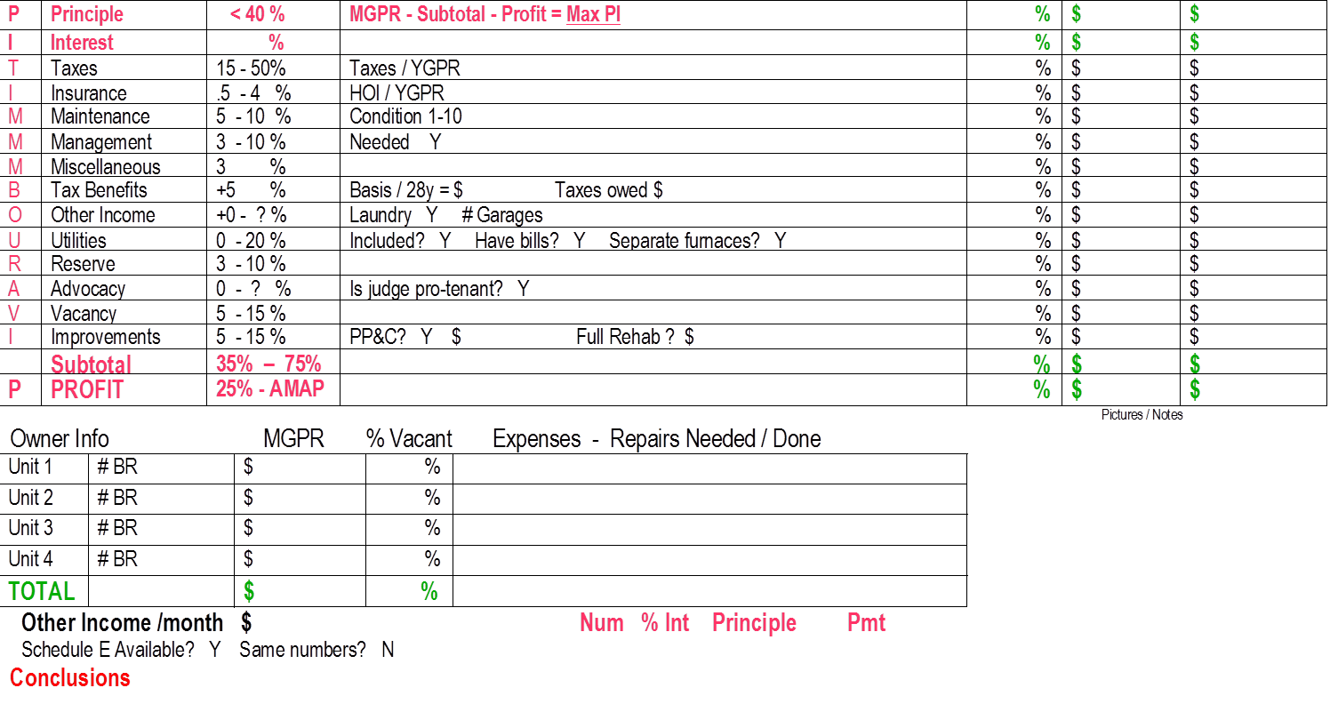

Slide 43
Property Evaluation Worksheet Property #____________________ # ___of #____
General Information Date ____________ School District________________________ How good_____
Property Address___________________________________City___________________________State____Zip______
Your Name_____________________________________________Home_________________Wk_________________
Address__________________________________________City___________________________State_____ Zip_____
Email _________________________________________________ Cell _________________ Pgr _________________
Who are the owners___________________________________________________ Type of property_______________
OO/NOO_________ Is Property Vacant______ How long Vacant_______ Amenities____________________________
#BR________ #Baths______ Total Sq Ft Bldg.____________ Lot Size __________________ Zoning_______________
Selling Information
1 How long have you owned property_______2 How long have you occupied property________3 Age of Structure_____
4 How long has property been for sale________5 Listed with broker______6 How many offers did you get? __________
7 Why do you think the property has not sold __________________________8 Date property must be sold by________
General Property Condition
9 How would you grade the condition of the property, from 1-10, with 10 being perfect___________10 How would you grade your property in relation to other houses in your neighborhood on a scale of 1-10 __________11 Email pictures [ ]
12 Are there any major repairs or maintenance needed in the property? Please list work needed and its cost _________
________________________________________________________________________________________________
13 What improvements would you make________________________________________________________________
Mechanical Systems and Services
14 What is the water source__________15 Has the water quality & flow rate been tested__________16 How old is the septic or cesspool system__________17 Date last pumped__________18 Who provides electrical service___________
19 What is the amperage__________ Does it have 20 circuit breakers[ ] 21 fuses[ ] 22 Any material defects_________
23 Does basement have seepage resulting in standing water_______________________ Are there any known material defects in these systems 24 plumbing______________25 security__________26 carbon monoxide detector__________
27 smoke detector__________28 fire sprinkler__________29 sump pump____________30 foundation/slab__________
31 interior walls/ceilings_________________32 exterior walls/siding_________________33 floors_________________
34 chimney/fireplace/stove______________ 35 patio/deck________________________ 36 driveway_______________
37 central air conditioner___________ 38 heating system___________________39 hot water heater_______________
Structural
40 Is there any rot or water damage____________________ 41 Is there any fire or smoke damage_________________
42 Have you tested for insect, rodent or pest infestation [ ] 43 Results________________________________________
44 What is type of roof covering___________45 How old is the roof_______46 Any known defects_________________
47 Are there any known material defects in the following structural systems: footings, beams, girders, lintels, columns partitions, chimney_________________________________________________________________________________
Legal
48 Has anyone made a legal challenge to the property____________________________________________________
49 Cert of Occupancy required [ ] 50 Does anyone have rights to use the property_______ 51 Does anyone else claim to own the property______________52 Are there judgments, tax or mechanic liens against the property_____________
53 Is there anything on the property that is shared in common: well, fences, driveway____________________________
Environmental
54 Has any part of the property ever been in a wetland, agricultural district or landfill_____________________________
55 Have there ever been fuel storage tanks above or below ground ______ 56Did they ever leak___________________
57 Has any petroleum product, methane gas or any hazardous or toxic item spilled, leaked or been released onto the property or onto another property_____________________________________________________________________
58 Has the property been tested for toxic substances_______________________59 Has a radon test been done______
60 Is there asbestos in the structure__________________________ 61 Is lead plumbing present __________________

Slide 44
Property Finances
61 What was original price of property?________ 63 How much DP?_______ 64 What’s current market value?_______
65 What is your asking price?_________________66 List the prices of comparable properties that have sold recently in your neighborhood_________________________________________________________________________________
67 What are the terms of the current first mortgage? 68 $__________________ 69 Rate________ 70 Date___________
71Yrs______ 72 How much are first mortgage monthly payments?___________ 73 Does it include re taxes, insurance and home owners association fees?_________ 74 If not what is annual tax $____________ 75 insurance$___________
76 HOA Dues$_________ Any arrearages: 77 Tax$__________ 78 Insurance$__________79 HOA Dues$__________
80 If payments on this mortgage are delinquent, by how many payments_____________81 How much to cure________
82 Who is the holder of this mortgage(Bank or individual)__________________________________________________
83 What are the terms of the second mortgage, if any $____________ 84 Rate_______85 Date________86 Yrs______
87 Is this an equity Line_________ 88 What is maximum amount available$______________89 Can you get more____
90 If payments on this mortgage are delinquent, by how many months_________91 How much to cure______________
92 Who is the holder of this mortgage__________________________________________________________________
93 What are the terms of the third mortgage, if any $_______________94 Rate_______95 Date________96 Yrs______
97 If payment on this mortgage are delinquent, by how many months__________98 How much to cure______________
99 Who is the holder of this mortgage?_________________________________________________________________
If in foreclosure, which mortgage(s) and how much 100 Mtg______ $____________101 Mtg _____________ $_______
102 Date of Notice or Lis Pendens___________103 Sale Date___________
104 Have you filed for bankruptcy______105 Which Chapter (7, 11, 13)_____106 Date of Discharge________________
107 If you are considering bankruptcy, which Chapter (7, 11 13)______________
108 What other liens or judgments, pending or actual are on property and their amounts?_________________________
Income and Expenses
109 If property is not currently a rental, how much do you feel it would rent for monthly?___________
110 If property is currently rented, provide the following information as monthly figures: Number of Units/Apts_________
111 Rent per unit 1-_______2-_______3-_______4-_______112 RE Taxes $____________113 Insurance $_________
114 HOA Dues $____________115 Legal $________arrearages 116 Taxes $____________117 Insurance $_________
118 Heat (if paid by owner) $___________119 Water $__________120 Utilities $________121 Repairs $____________
122 Management $__________123 Vacancy $_________124 Replacement Costs $________125 Advertising$______
Problem Analysis
What is the reason you must get rid of this property? Please check all that apply:
126 Carrying two mortgages [ ] 127 Divorce [ ] 128 Must split with heirs[ ] 129 Relocating [ ] 130 Job Loss [ ]
131 Business failure [ ] 132 Can not afford [ ] 133 To avoid foreclosure [ ] 134 Medical Bills [ ] 135 High debt [ ]
136 Can no longer manage property [ ] 137 Losing money on property [ ] 138 Need cash for____________________
139 How much cash is needed $________ 140 If your property does not qualify for this program, what will you do?
____________________________________________________________________________________________
Or, select from the following list:
141 List with another broker [ ] 142 Walk away and let the bank take it [ ] 143 Rent the house [ ] 144 Discount property 30% for a quick sale [ ] 145 Take off the market and try again in a year [ [ 146 Go bankrupt [ ] 147 Sell for mortgage amount [ ] 148 How important is it to re-establish your credit? (1-10)_______________________
SOLUTIONS
148 Are you able to accept your profit monthly?________ 149 Where will you go after you leave this home?___________
150 How much cash do you actually need to move on?________ 151 Can I Option the home and market it.___________
152 When I sell the home, we can split any profit._____________ 153 I can pay the arrearage if you give me the deed. You can stay in the property ifyou pay a rental until you are able to buy the property back.______________________________
154 If I take over the responsibility of your debt will you sign the home over to me?______ NOTES + PICTURES

Slide 45
Seller's Acknowledgments
I/we ______________________________________________________and
______________________________________________________(Seller(s), on this ____ day of ______________________, 201____, has/have agreed in writing to sell the property commonly known as
_________________________________________________, (The Property) to _________________________________________ (Buyer) and or assigns, according to the terms and conditions contained in the Purchase and Sale Agreement (The Agreement) of even date, a copy of which is attached hereto. I/we further state as follows:
INITIAL EACH ITEM
____/_____ 1. OWNERSHIP OF THE PROPERTY: I/we am/are the owner(s) of The Property (or I/we have an equitable interest in The
Property) and am/are able to contract for its sale.
_____/_____ 2. ACCEPTANCE: I/we have reviewed the terms and conditions contained in The Agreement and have accepted Buyer's offer to purchase The Property.
_____/_____ 3. GOOD AND VALUABLE CONSIDERATION: I/we have received good and valuable consideration in signing The Agreement, and
I/we acknowledge both the receipt and the sufficiency of the consideration.
_____/_____ 4. IN MY BEST INTEREST: I/we am/are satisfied with The
Agreement and have agreed to sell The Property because it is in my best interest to do so.
_____/_____ 5. FULLY INFORMED AND NOT CONFUSED: I/we have signed
The Agreement being fully informed and with sufficient understanding of all terms and conditions contained therein. I/we am/are not confused about any aspect of The Agreement.
_____/_____ 6. SATISFIED WITH THE SALES PRICE: I/we understand I/we may be selling The Property for less than market value but have chosen to do so because circumstances dictate that an immediate sale, even at a discounted price, is in my/our best interest. I/we am/are satisfied with the sales price I/we have negotiated.

Slide 46
_____/_____ 7. SALE IS FINAL: I/we understand by signing The Agreement, that I/we have agreed to sell The Property to Buyer and am/are now bound by the terms and conditions described in The Agreement. I/we further understand that I/we cannot change my/our mind or cancel the contract at some later date, nor can I/we continue to market The Property to any other buyer.
_____/_____ 8. CONTINGENCIES MAY EXIST: I/we understand the sale may be contingent upon Buyer's inspection and approval of certain items described in The Agreement. I/we further understand that if Buyer does not approve of these items, Buyer may cancel The Agreement and if canceled, I/we must return Buyer's earnest money in full.
_____/_____ 9. NOT A LOAN: I/we understand The Agreement I/we have signed is for the outright sale of The Property and is not intended to be a loan of any kind.
_____/_____ 10. AGREEMENT MAY BE ASSIGNED: I/we understand Buyer may assign The Agreement to another party and I/we may be closing the sale with someone other than current Buyer.
_____/_____ 11. NO ESCROW: I/we understand Buyer may choose to close this transaction without the use of an escrow company and may record the conveyance documents himself.
_____/_____ 12. CLOSING DOCUMENTS: I/we understand there will be additional closing documents to sign and upon receipt, agree to sign and deliver the closing documents, in a timely manner, either into Escrow or directly to Buyer, as Buyer may direct.
_____/_____ 13. COPIES OF THE PAPERWORK: I/we understand that copies of the paperwork I/we have signed will be provided to me/us in a timely manner and I/we acknowledge that circumstances dictate that copies may not be immediately made available to me/us.
_____/_____ 14. BUYER ENTITLED TO MAKE A PROFIT: I/we understand
Buyer may resell The Property and may realize a profit in doing so. I/we agree Buyer is entitled to any profit that may ultimately result from the subsequent resale of The Property.

Slide 47
_____/_____ 15. LEGAL COUNSEL ADVISED: I/we acknowledge Buyer has advised me/us to seek independent legal counsel to review The
Agreement.
_____/_____ 16. FINANCIAL REVIEW ADVISED: I/we acknowledge Buyer has advised me to seek an independent financial advisor to review The
Agreement.
_____/_____ 17. FAIRLY NEGOTIATED: I/we understand Buyer has negotiated on his own behalf and likewise, I/we have negotiated on my/our behalf. I/we acknowledge The Agreement has been negotiated fairly and Buyer has not taken advantage of me/us or my/our current situation.
_____/_____ 18. NO PRECLUDING AILMENTS: I/we have no physical, mental or emotional ailments that preclude me/us from signing The Agreement.
_____/_____ 19. NOT UNDER THE INFLUENCE: I/we am not now under the influence of alcohol or any other mind-altering substance, nor am/are I/we taking medication that would cloud my/our judgment or make me/us unable to think clearly.
_____/_____ 20. NO OTHER PROMISES: I/we have not been promised anything other than what is described in The Agreement. There are no unresolved issues, no “side agreements,” nor are there other terms not disclosed in The Agreement.
_____/_____ 21. NOT UNDER DURESS: I/we am/are not under duress and have signed The Agreement of my/our own free will, without any undue financial pressure. Buyer has in no way pressured me into signing
The Agreement.
_____/_____ 22. FULLY SATISFIED WITH AGREEMENT: I/we am/are fully satisfied with the all terms and conditions contained in The Agreement.

Slide 48
IF- THEN ROLE-PLAYING EXERCISE
If you say this, then they may say that, that or that, and you may reply with this, that or another question or statement to each of their replies, etc.
Follow the levels: L1Q1 to L2R1 to L3A1 to L4R1 to L5A1 to L6R1 to L7A1
Some version of: Yes – No – Maybe

Slide 49
Your Opening Question/Statement: Level 1 Question 1 or Statement 1
L1Q1 or S1 __________________________________________________
Others Potential Replies / Questions: Level 2 Reply 1, 2 or 3
L2R1 ____________________________________________________________
L2R2 _______________________________________________________
L2R3 _______________________________________________________
Your Potential Answers / Questions: Level 3 Answer 1, 2 or 3
L3A1A ______________________________________________________ or
L3A1B ______________________________________________________
L3A2A ______________________________________________________ or
L3A2B ______________________________________________________
L3A3A ______________________________________________________ or
L3A3B ______________________________________________________
Others Potential Responses / Questions: Level 4 Response 1, 2 or 3
L4R1 _______________________________________________________
L4R2 _______________________________________________________
L4R3 _______________________________________________________
Your Potential Rebuttals / Questions: Level 5 Answer 1, 2 or 3
L5A1 _______________________________________________________
L5A2 _______________________________________________________
L5A3 _______________________________________________________

Slide 50
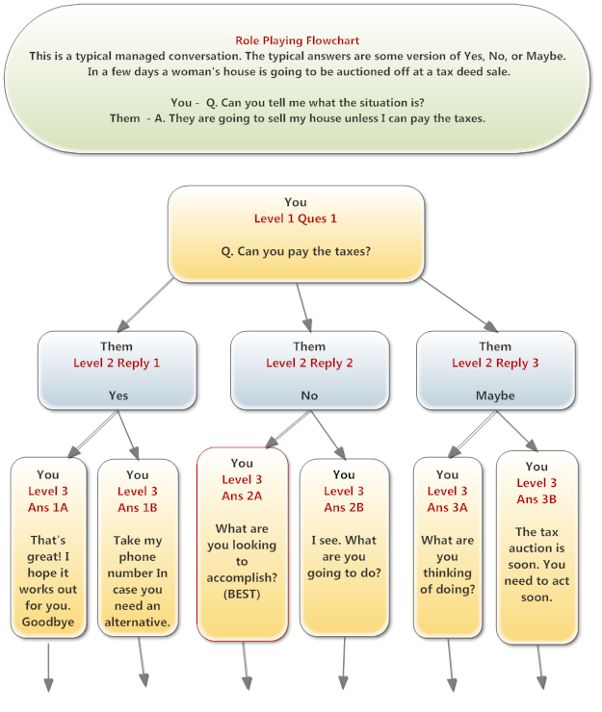

Slide 51
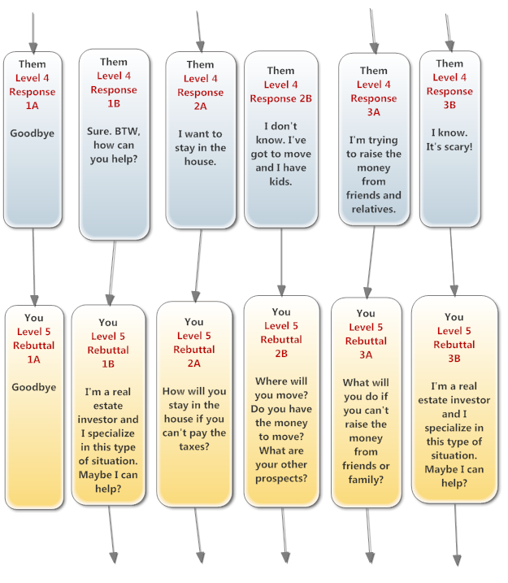

Slide 52
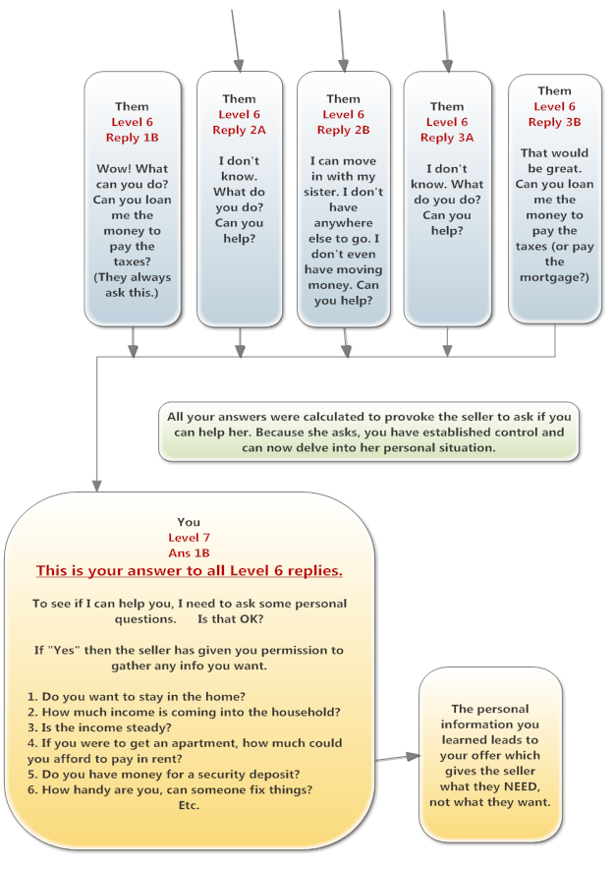

Slide 53
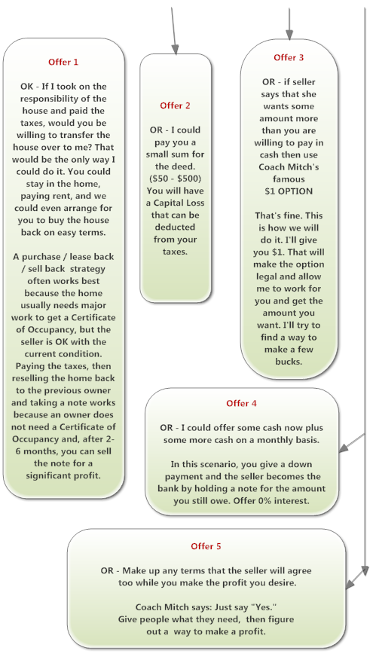

Slide 54
1.Participate in the Forum
2.Call with any questions / concerns
3. Make the most out of this opportunity for you, for your family, for your future.

