Slide 1
Module 3A – Sell Any Property in 5 Days
Real Estate
Auctions

Slide 2
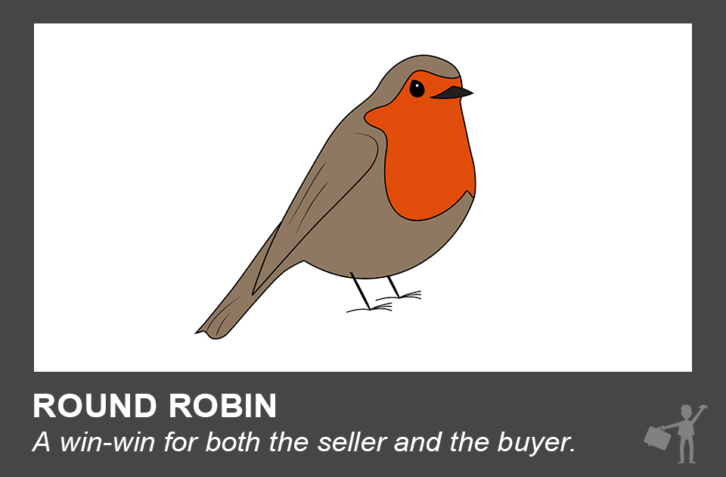
Introduction to Round Robin Auctions
Basically the Concept behind Round Robin Auctions is that you combine the process of an auction with doing an open house

Slide 3
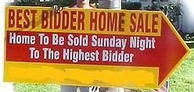
Introduction to Round Robin Auctions
It is a great way to sell properties:
It creates a sense of urgency;
It generates a lot of foot traffic;
It helps getting the best offer that the market demands at that time.

Slide 4
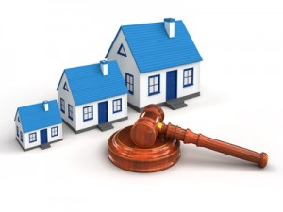
Introduction to Round Robin Auctions
The general idea of the process works like this:
Day 1-5: Offer your home for 50% of what it’s worth.
Day 4-5: Show your home.
Day 5: Sell your home for 100% of what it’s worth.

Slide 5
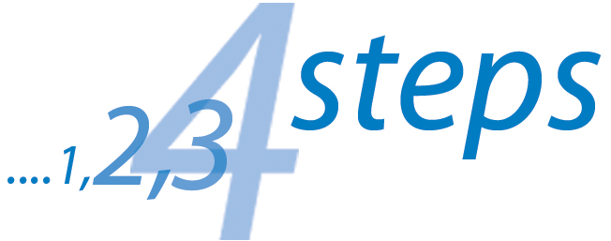
Introduction to Round Robin Auctions
Module 3B

