Slide 1
Module 1B – The Auction Process
Real Estate
Auctions

Slide 2
Step 1 – Locating Properties
Foreclosures: Research the Notice of Defaults filed at the Recorder of Deeds Office or Legal Paper
Tax Auctions: Research the list of Tax Delinquent properties
published prior to the auction
Private Auctions: Join the Mailing List or Check Website

Slide 3
Step 2 – Confirming the Auction
Call the Trustee (Foreclosures) or Public Auction the day before the auction:
Is the auction still on?
What time and location?
How much deposit at auction?

Slide 4
Step 3 – Valuation
Check Value (through CMA – Comparative Market Analysis –
properties sold in the last 6 months)
Determine Bid Amount

Slide 5
Tip: Organize your Data
See Attached Sample Spreadsheet

Slide 6
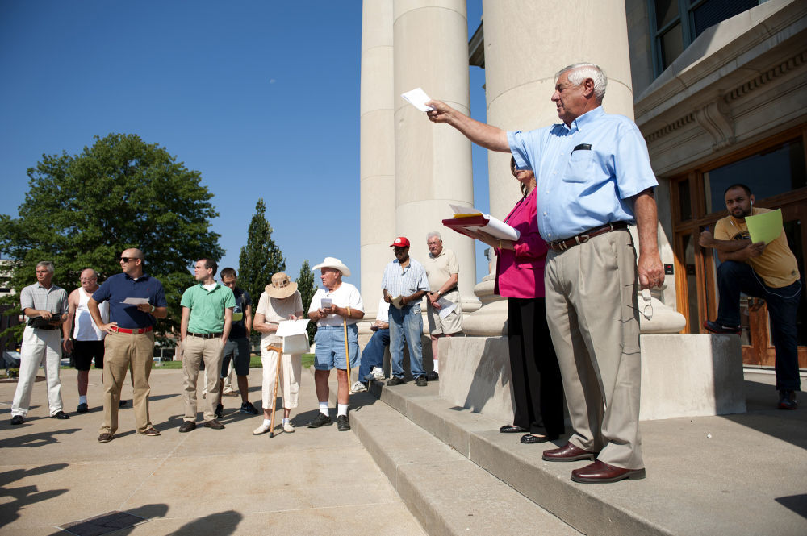
Step 4 – Bidding at Auction
Important Recommendations:
Don’t be intimated by more experienced
investors at the auction
Stick to your maximum bid amount

Slide 7
Step 5 – Taking Ownership
Confirm with Trustee/Auctioneer
at the End of the Auction
Record Deed (after receipt)
For Tax Lien Auctions
You have to wait until the end of the redemption period to file for the deed

