Slide 1
Mindset of a Successful Real Estate Investor

Slide 2
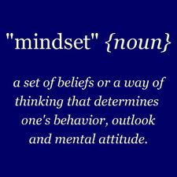
Topics
The “Four Keys” to Becoming Successful in
Real Estate
The 5 Pitfalls to Avoid as an Investor
Recipe for Success
Nothing can stop the man with the right mental attitude from achieving his goal; nothing on earth can help the man with the wrong mental attitude. Thomas Jefferson

Slide 3
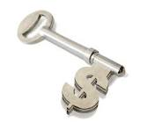
4 Keys to Success
Thinking Rationally versus Emotionally
Not Living in Fear of Losing Money
Prevailing Procrastination
Response to Fear Makes the Difference

Slide 4
5 Pitfalls to Avoid
Time Management
Fear of Failure
Fear to Implement
Perseverance
Invest in Education

Slide 5
Recipe for Success
Step 1: Give Yourself a Deadline
Step 2: Focus and Determination
Step 3: Structure/Manage your Work Time
80% money making activities
20% not money making activities
Step 4: Unplug from your “limiting beliefs”
see book list in Module 1

Slide 6
Recipe for Success
Step 5: Break Goals into Smaller Steps
Small Tasks
Milestones
End Goals

Slide 7
Recipe for Success
Step 6: Just Do It!

