Slide 1
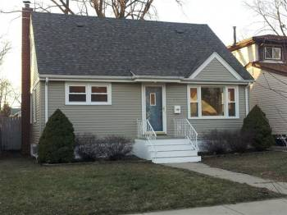
Analyzing a Deal
Rule of 70
Asking Price $79,900
Comparables in the area
$95,000 (Quick Sale) to $119,000 (High Wholesale)
Offer price
($95k+$119k)/2 x 70%=$74,900
if $15,000 rehab needed
($95k+$119k)/2x 70%-$15,000=$59,900

Slide 2
Paperwork
Sale Contract (2 pages – keep it simple)
Contingency
“Contingent to Business Partner’s Approval within 15 days of acceptance of sale contract.”
Lead Based Paint Addendum
Seller’s Disclosure – “As Is”

