Slide 1
The 5 core strategies of wholesaling
by Laura Al-Amery

Slide 2
#4 – build a scalable proven system
Focus
Delegate
Automate
www.sweetprocess.com

Slide 3
The 5 core strategies
“Simple” Wholesaling
Virtual Wholesaling
Co-Wholesaling
Assignments
Joint Ventures

Slide 4
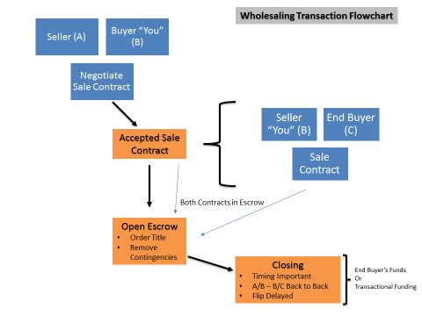
“simple” wholesaling

Slide 5
5 Steps to wholesaling
Step 1: Build a “Qualified” Buyers’ List
Step 2: Locate Properties
Distressed Sellers
Go to the source
** Direct Approach **
Step 3: Run Comps and Due Diligence

Slide 6
5 Steps to wholesaling
Step 4: Purchase the Property
Title Company Considerations
Step 5: Present the Property to your Buyers List
Qualified List is Important
Use MLS as last resort
Loophole Contingencies on Sale Contract

Slide 7
Tips to wholesaling
Secure Financing with Transactional Funding or JVs & Close
Important Recommendations for setting up a wholesaling machine –
Organize and Automate
Delegate
Take action

Slide 8
Virtual wholesaling
Why wholesaling long distance?
Better Markets
Less Competition
Diversification
Recommendations
Wholesale locally first
Organization is key
Ability to delegate

Slide 9
Virtual wholesaling
Step 1: Research Markets
Realtor.org – National Association of Realtors
ngkf.com – Newmark Grubb Knight Frank
Step 2: Contact local agents and contractors
Browse craigslist
Local REIA and Meetup groups

Slide 10
Virtual wholesaling
Step 3: Take a trip!
Interview 2-3 agents and contractors
Have them show you around different areas
Step 4: Build a Buyers’ List
Same strategy as for local strategy
One buyers’ list per area

Slide 11
Virtual wholesaling
Step 5: Locate properties
Can be done virtually
Your out of town agent and contractor are your “eyes and legs”
Step 6: Title company & Financing
Nationally connected

Slide 12
Co-wholesaling
Partnership=Quicker Results
Better Than BirdDogging (50/50 Split)
Segmentation by Markets

Slide 13
Co-wholesaling
Step 1 – Find Possible Partners
- Bandit Signs - Blind Ads
- Craigslist – Look for “Trigger Words”
- Google “wholesaler” + your city
Step 2 – Selection Process
- Investors with properties and/or
buyers
- Cash Investors (see JVs later)

Slide 14
Co-wholesaling
Step 3 – Sign Co-Wholesaling Agreement
Step 4 – Locate Buyers and/or Properties
Step 5 – Sign Sale Contract
Rinse & Repeat

Slide 15
Bonus Co-wholesaling strategy
Locate Properties Across Markets (Virtual Wholesaling)
Locate Local Wholesalers
Assign the Deals to Them under a
Co-Wholesaling Agreement

Slide 16
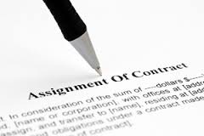
assignments
Assign Contract to End Buyer
Good Practice
Profit is less than $5k
Deed Restrictions

Slide 17
Joint ventures
Set Expectations
Sources of JVs:
When you look for co-wholesalers
Research recent cash sales
Referrals by agents, mortgage brokers, title companies
Networking – social media & club meetings

Slide 18
Enrollment Tips
Invite people that you know (per SEC, you should have talked to them 3-4 times – email count)
Partner with people who know potential investors:
Mortgage Brokers
Title Companies
Real Estate Agents
Other Investors/Networking/Clubs

Slide 19
Enrollment Tips
ales
Co-Wholesalers
Recent Cash Sales
Advertising – ONLY for informational meeting
Don’t be pushy – be transparent

Slide 20
Who are the Possible Investors?
Anyone with Funds Available (at least $25k)
Older people nearing retirement
People who do not want to deal with day to day operations
Investors who are already in real estate but looking to spread into other areas

Slide 21
Possible Sources of Money
Savings
Mutual Funds
Credit Lines (Business and HELOC)
Self Directed IRAs or 401K
Insurance Policies with cash value (5+ yrs)
You as the Syndicator have to educate
the Private Lenders

Slide 23
Private Lender Kit
Business Cards/Brochure
Credibility:
Company Info
Past Deals and/or Current
Resume
Testimonials or Referrals

Slide 24
… continuation
Details on at least one possible deal
Photos, Figures
What is in it for them?
Ask them for their interests and goals
Emphasize ROI
Give them Timeline
Advantages of Working with You

