Slide 1
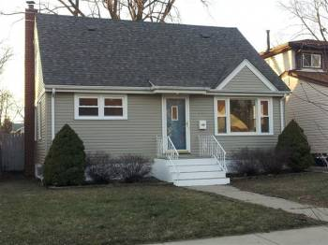
Pricing Strategy
4 Weeks Marketing Time
Week 1 – Price at $114,900
Blast to:
Buyers’ List
Internet – Blog Syndication
Forums
Social Media
Week 2 – Drop Price about 5%
i.e. $109,900
Week 3 – Drop Price about 10%
i.e. $99,900

Slide 2
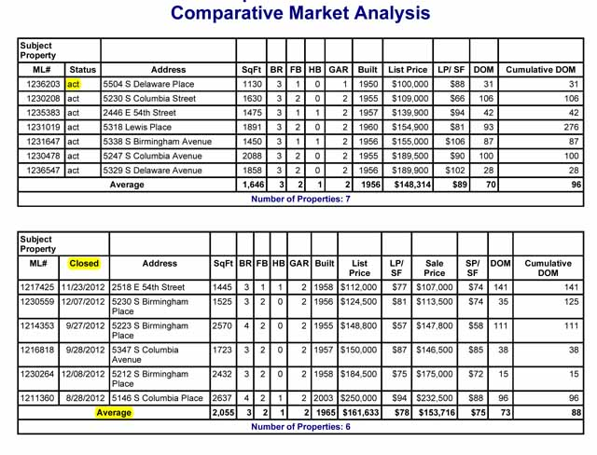
Sample CMA

