Slide 1

Marketing for Real Estate Investing

Slide 2
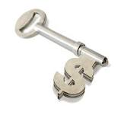
Marketing for Buyers
1. Cash Buyers are Best
MLS Search cash sales in the last 6 months
Auctions
  Court Auctions
  Private Auctions
    HudsonandMarshall.com
    WilliamsandWilliams.com
Linkedin
  Search keyword “Portfolio Manager” “Asset Manager”
  Join local real estate group

Slide 3
Marketing for Buyers
2. Website
  Offer free report
  Optimized for geographical area (Google PPC,
  Google Local, etc)
3. Bandit Signs
  Strategic Locations and Strategic Times
  2 lines only – catchy headline and phone number

Slide 4
4. Advertising Online and Offline
Your website, your phone number
Craigslist, Backpage, Business Cards, etc.
Host Free Seminar
“How to Buy Property for Long Term with No Money or Credit”
“How to Find Private Lenders”
Marketing for Buyers
4. Advertising Online and Offline
  Your website, your phone number
  Craigslist, Backpage, Business Cards, etc.
5. Social Media
  Linkedin, Facebook, Twitter, Google+
  HootSuite.com
6. Auctions
Attend auctions and exchange business cards

Slide 5
4. Advertising Online and Offline
Your website, your phone number
Craigslist, Backpage, Business Cards, etc.
Host Free Seminar
“How to Buy Property for Long Term with No Money or Credit”
“How to Find Private Lenders”
Marketing for Sellers
Website
  Targeting distressed sellers
  Offer free report
  Optimized for geographical area (Google PPC,Google Local, etc)
Search and Post on Classified Ads Online and Offline
  Look for words like “Motivated Seller” or “Must Sell”
  Post your site and phone number

Slide 6
4. Advertising Online and Offline
Your website, your phone number
Craigslist, Backpage, Business Cards, etc.
Host Free Seminar
“How to Buy Property for Long Term with No Money or Credit”
“How to Find Private Lenders”
Marketing for Sellers
3. Direct Marketing
Oversized Postcards (Vistaprint), Preforeclosure letters, etc. (see the Best Direct Marketing Strategy)
4. Bandit Signs
  Strategic Locations and Strategic Times
  2 lines only – catchy headline and phone number
5. Wholesalers
  They have sellers
  They can find properties

Slide 7

An Agenda and Framework for Marketing
1
set marketing GOALS and OBJECTIVES
2
run CAMPAIGNS on the CHANNELS that matter
3
get measurable RESULTS

Slide 8

Marketing
goals
1
set marketing GOALS and OBJECTIVES
Reach New Clients
Drive Repeat Business
Nurture Leads
Qualify Prospects

Slide 9
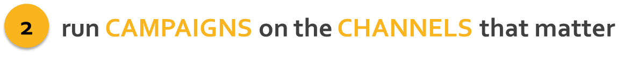

Types of Campaign
Email – Share Information/Newsletter
Social Media – Network and Build Your Network
Events Invites and Updates
Articles and Updates – Become an Expert

Slide 10
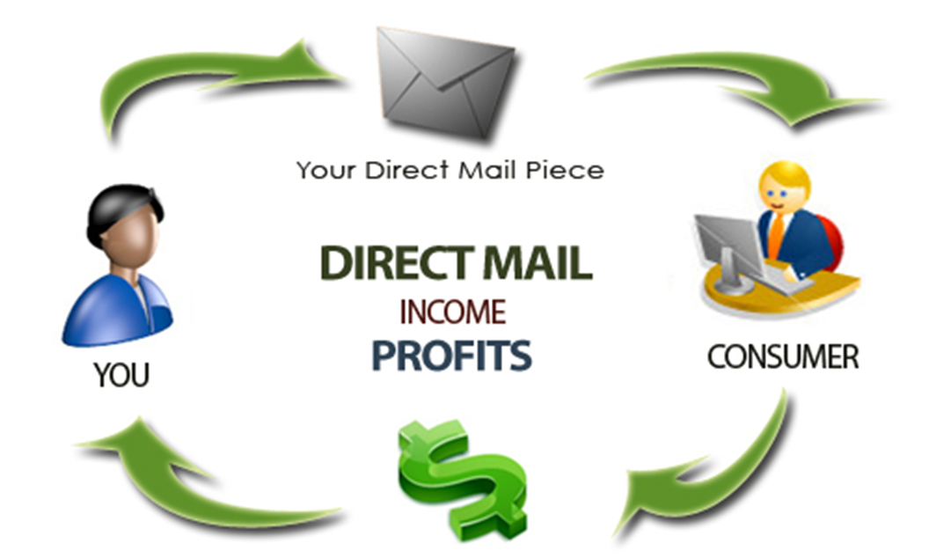
Direct Marketing

Slide 11

Direct Marketing
Look Professional
Use Letter with Envelope or Oversized Postcard
Highlight Benefits to Them (It is not about you)
Be Yourself and True
Offer Something of Value (Money, Assistance)
Make Them Open the Envelope (“Trigger” Line)

Slide 12







Social Media
Which Channels Matter for Real Estate?
Drive Leads to You
Syndicate

Slide 13
Blogging
Start Blogging Today!
Blogging increases overall visibility & is a chance to give your business some personality
Blogs should be located on your website. This is because each blog ‘post’ is typically counted as one page on a website and improves the visibility of the website.
Use a content management system for blogging such as WordPress to keep things organized and easy. This not only saves time, but WordPress is designed for blogging and fast updates.

Slide 14
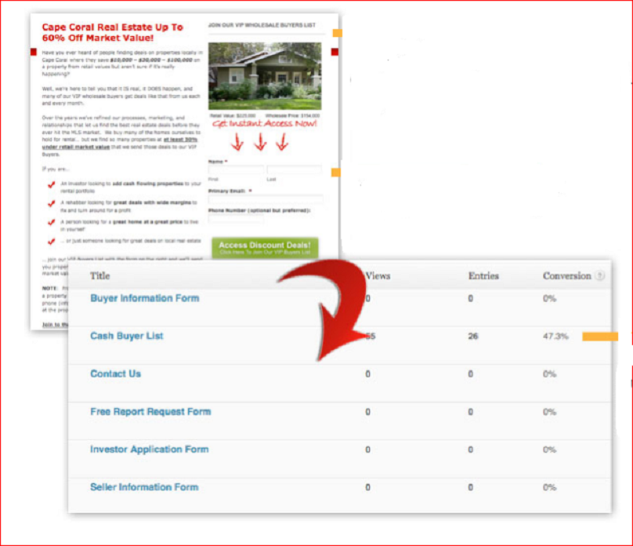
Landing Pages
** Very Important in Building Leads’ Lists (Buyers and Sellers) **

Slide 15





Advertising
Internet Advertising
Offline Advertising

Slide 16

Example of Internet Syndication
  WordPress Site (Blog)
    Posts for content & building brand
    Every property a post
  Video (YouTube) for every property
  Mobile site (DudaMobile)

Slide 17

Sell a Property in 3 Weeks
4 Weeks Marketing Time
Week 1 – Price at $114,900
Blast to:
              Buyers’ List
              Internet – Blog Syndication
                Forums
              Social Media
Week 2 – Drop Price about 5%
i.e. $109,900
Week 3 – Drop Price about 10%
i.e. $99,900

Slide 18





Example of Internet Syndication
monitor
+
schedule

Slide 19





Measure Results
3
get measurable RESULTS
Marketing is about measurable RESPONSE
Results are measurements of actions

