Slide 1
Dodd-Frank Act

Slide 2
The Dodd-Frank Act
Apply only when investor sells to a buyer as owner occupant with owner financing
Free Pass or 1 deal a year rule:
Straight forward deal/balloon ok
Persons, estates and trusts
3 deals a year rule:
No balloon payments
Persons, estates, trusts and corporations
More than 3 deals:
Use a licensed mortgage originator

Slide 3
The Dodd-Frank Act
3 deals a year rule:
No balloon payments
Persons, estates, trusts and corporations
More than 3 deals:
Use a licensed mortgage originator
More than 3 deals:
Use a licensed mortgage originator

Slide 4
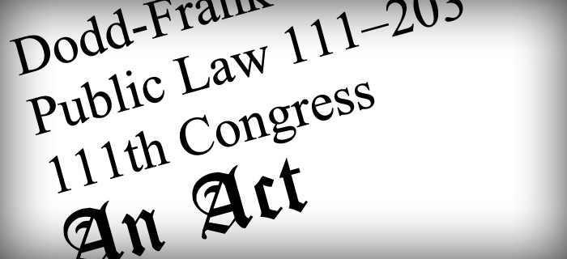
Facts about the The Dodd-Frank Act
Most investors do not need to worry about the Dodd-Frank Act
It is easy to get a license as a mortgage originator
Investors buying with lease options, owner financing or ‘subject to’ do not apply
Rent & Lease Options qualify as proving borrower’s viability

