Slide 1
Essentials of Building a Buyers’ List

Slide 2
The 8 Best Ways
** MLS Search
Look for properties/cash buyers in the last
6 months.
** Bandit Signs
Handwritten 18x24 yellow corrugated signs.
Wholesalers
Network with wholesalers/co-wholesale
** Squeeze/Landing Page
Set up an Opt-in and Autoresponder service.

Slide 3
The 8 Best Ways
Online Advertising
Craigslist, Backpage, Meetup Bulletins
** Social Media
Linkedin, Facebook, Twitter, Google+
7. For Rent Signs (Drive for Dollars)
Landlords are possible investors/buyers
8. ** Auctions
Attend auctions and exchange business cards
** Laura’s preferred

Slide 4
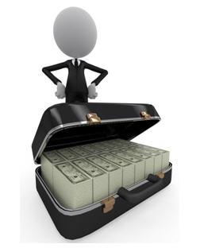
Where are the Cash Buyers?
MLS Search
Cash sales in the last 6 months
Auctions
Court Auctions
Private Auctions
HudsonandMarshall.com
WilliamsandWilliams.com
Linkedin
Search keyword “Portfolio Manager” “Asset Manager”
Join local real estate group

Slide 5
Manage your Buyers’ List
Educate your buyers to become investors
Keep in contact via email or newsletters
Send surveys – SurveyMonkey.com
Keep a preferred list of buyers:
Call them when you have a property available
for their criteria
Arrange meetings
or lunch with them

