Slide 1
Strategic Action Plan

Slide 2
Pre-Action Plan
Business Organization
Team Development
Education
Gather Tools and Information

Slide 3
Action Plan
Step 1: Decide on a Geographical Area (zip codes, neighborhood)
Demand (cash buyers & sales volume)
Start with lower to mid range homes
Step 2: Decide on 1 Strategy at a Time
and break it in smaller tasks
Direct Marketing/Mailing
Drive for Dollars
Internet Lead Generation

Slide 4
Action Plan
Step 3: Start Building your Buyers’ List
1 Strategy at a Time (Module 2)
Cash Buyers Strategies
Internet Lead Generation
Step 4: Follow Up Strategy
Autoresponder
CRM – Realtyjuggler.com

Slide 5
Action Plan
Step 5: Locate Properties
Free Leads (Social Media, Software Tool)
Paid Leads (Direct Marketing)
Step 6: Set Up Goals
3 Contracts a Week (Wholesaling)
1 Purchase a Quarter (Buy & Hold)
10 Properties under contract by …

Slide 6
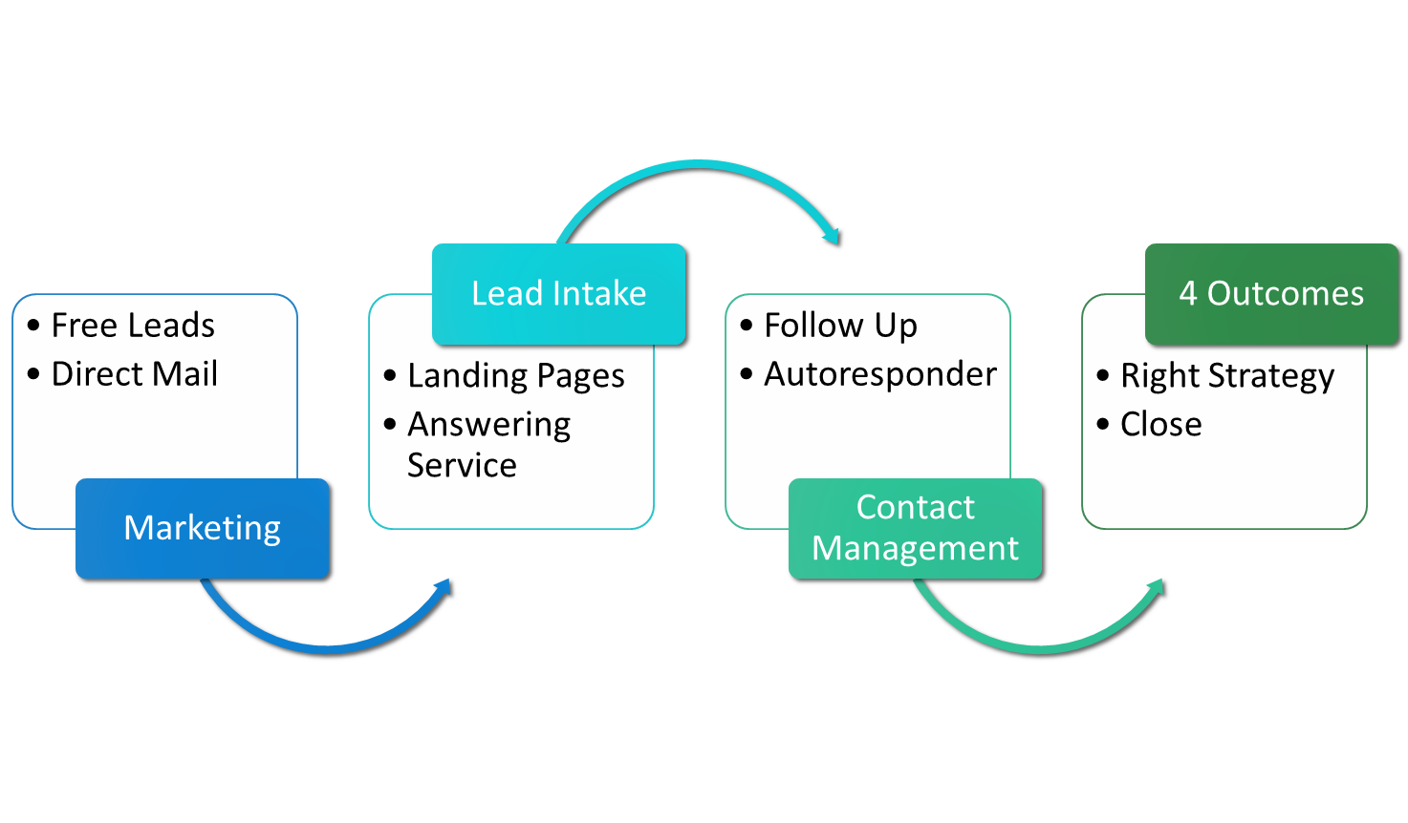
System Summary

