Slide 1
Module 1B – Choosing the Right Strategy
How to Build a Passive Income Portfolio
with Creative Financing & Private Money

Slide 2
3 Main Types of Passive Income
Passive Income
Rental or Option Income
Generate Notes
Partnerships

Slide 3
Seller Financing
Lease Option to Buy
Master Lease Option (commercial)
Subject To … (existing mortgage staying in place)
Owner Financing
First Position – Free & Clear – 100% Funding Possible
Second Position – Second or Partial Mortgage funding
Wrap Around Mortgage
Land Contract, Contract for Deed

Slide 4
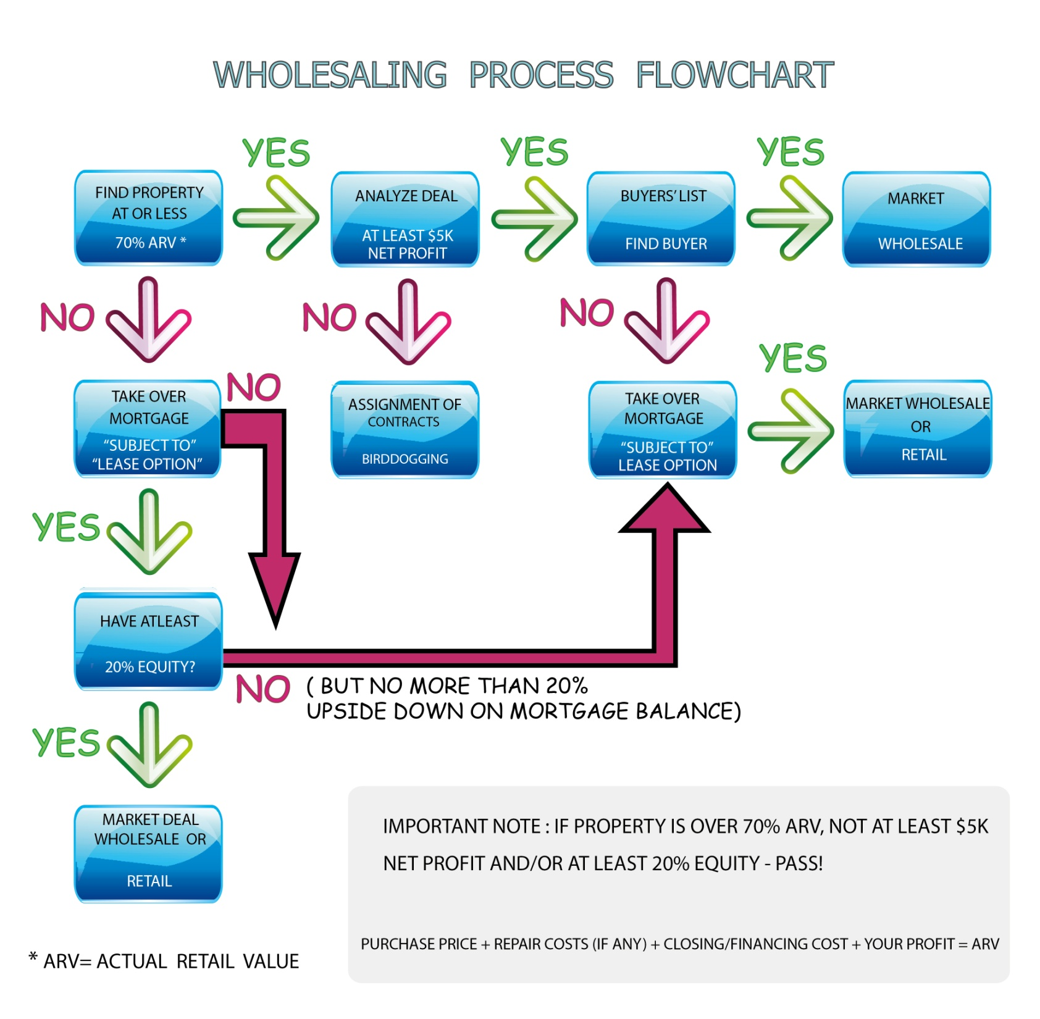
or After Repair Value

Slide 5
Money Partners
Anyone with Funds Available
Older people nearing retirement
People who do not want to deal with day to day operations
Investors who are already in real estate but looking to spread into other areas
Bonus Tip – “Transition” your Cash Buyers to Become Money Partners Instead

Slide 6
Who are Immediate Money Partners?
Cash Buyers

Slide 7
Money Partners
Partner with them, instead of wholesaling the deal “as is” to them
Split on the first deal to their advantage, then negotiate

Slide 8
Money Partners
MLS Search
Cash sales in the last 6 months
Auctions
Court Auctions
Tax Auctions
Private Auctions
HudsonandMarshall.com
WilliamsandWilliams.com
Linkedin
Search keyword “Portfolio Manager” “Asset Manager”
‘Straight’ Cash Purchases
Used Private Money

Slide 9
Money Partners
Other Wholesalers
Co-Wholesale or Partner
Title Companies
They know who close for cash
Real Estate Agents (dealing with investors)
They have cash clients (will work for commission)
Join Local Real Estate Group

Slide 10
Generate Notes
Wholesale a Deal
PP $50k
Buyer Buys Cash
SP $70k
Financing
80/20
SP $70k
You can ‘create’ a 1st or 2nd Mortgage up to $20k

Slide 11
Example
Wholesale or Fix & Flip or Retail
Your Purchase Price $50,000
Re-Sell Price $70,000
Your Potential Profit $20,000
You can Sell It:
Cash Price $70,000
Cash/Loan + 2nd Note $55,000 Cash/Loan
$15,000 2nd Note
Your “Walk Away” Cash at Closing $5,000

Slide 12
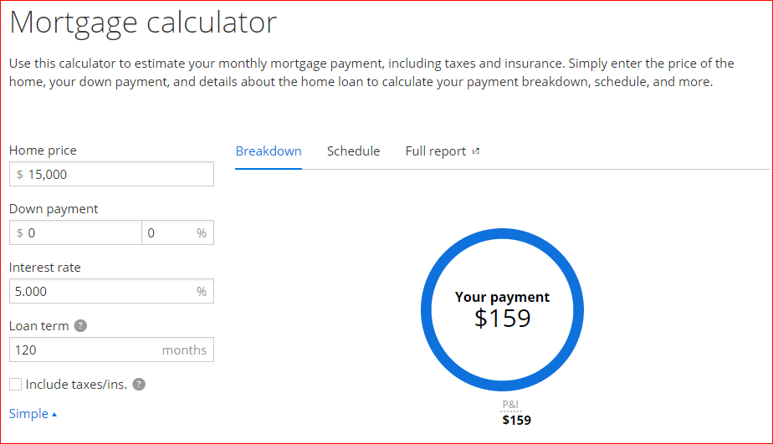
Example

