Slide 1
Module 1 - Introduction
How to Build a Passive Income Portfolio
with Creative Financing & Private Money

Slide 2
The 3 Phases of Buy and Hold
Phase 1 – Acquisition Phase
Phase 2 – Management Phase
Phase 3 – Exit Phase

Slide 3
Phase 1 – Acquisition Phase
Education/Rapid Growth
Issues with Financing
Cash Flow Concerns

Slide 4
Phase 2 – Management Phase
Equity is Growing
Exploring Different Avenues
Personal Strategy Takes Shape
Management and Maintenance

Slide 5
Phase 3 – Exit Phase
Living Off the Portfolio Rewards
Concerns with Taxation and
Distribution of Wealth
Knowing When You Have
Had Enough

Slide 6
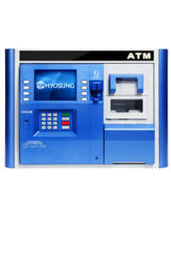
Pros & Cons
Short Term / Wholesale | Long Term / Buy & Hold
Needs to time the market | Less concerned with timing
Looks to buy low and sell high | Focus on sustaining assets
Needs to be able to liquidate quickly | Interested in long-term growth
Wants to minimize holding and selling costs | Wants to efficiently manage properties and equity
Proceeds from sales are used to increase lifestyle and re-invest | Focuses on rate of return on equity
Long Term = Builds Wealth
Short Term = Quick Cash
Long Term = Builds Wealth
Short Term = Quick Cash

Slide 7
Vertical vs Horizontal Investing
Vertical Investing
Less properties, but with more units per property (Commercial over 4 units.)
Horizontal Investing
Several residential properties (4 units or less.)

Slide 8
My Recommendations
Don’t Buy More than 3-5 properties
the First Year
Take Care of Today’s Cash Flow Needs
You Should Do Little to No Repairs
the First Year in the Business

