Slide 1
Meeting of the Minds
The Enrollment Process

Slide 2
Enrollment Tips
Invite people that you know (per SEC, you should have talked to them 3-4 times – email count)
Partner with people who know potential investors:
Mortgage Brokers
Title Companies
Real Estate Agents
Other Investors/Networking/Clubs

Slide 3
Enrollment Tips
Co-Workers
Public Records
Advertising – ONLY for informational meeting
Don’t be pushy – be transparent

Slide 4
Who are the Possible Investors?
Anyone with Funds Available (at least $25k)
Older people nearing retirement
People who do not want to deal with day to day operations
Investors who are already in real estate but looking to spread into other areas

Slide 5
Possible Sources of Money
Savings
Mutual Funds
Credit Lines (Business and HELOC)
Self Directed IRAs or 401K
Insurance Policies with cash value (5+ yrs)
You as the Syndicator have to educate
the Private Lenders

Slide 7
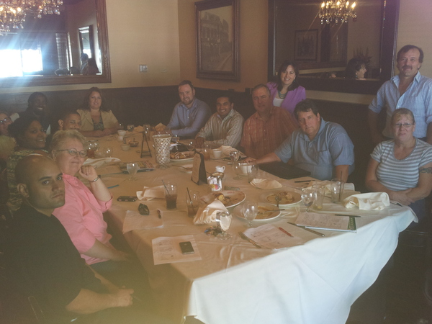

Slide 8
